Slide 1
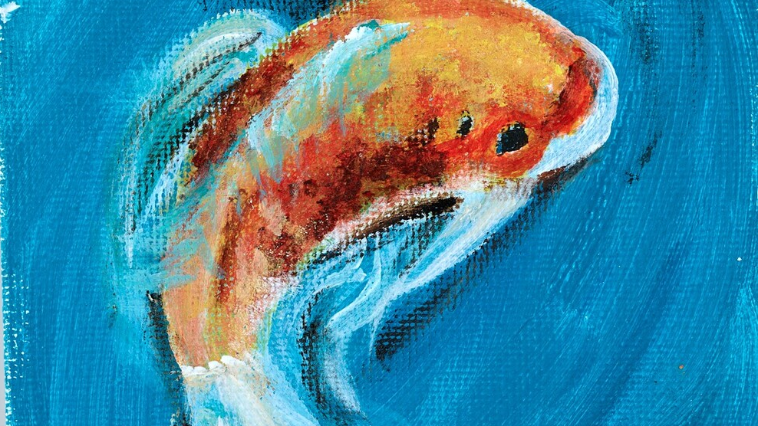
Army, Art, Archives:
Archival Engagement and Outreach in an Academic Service Academy Library

Slide 2
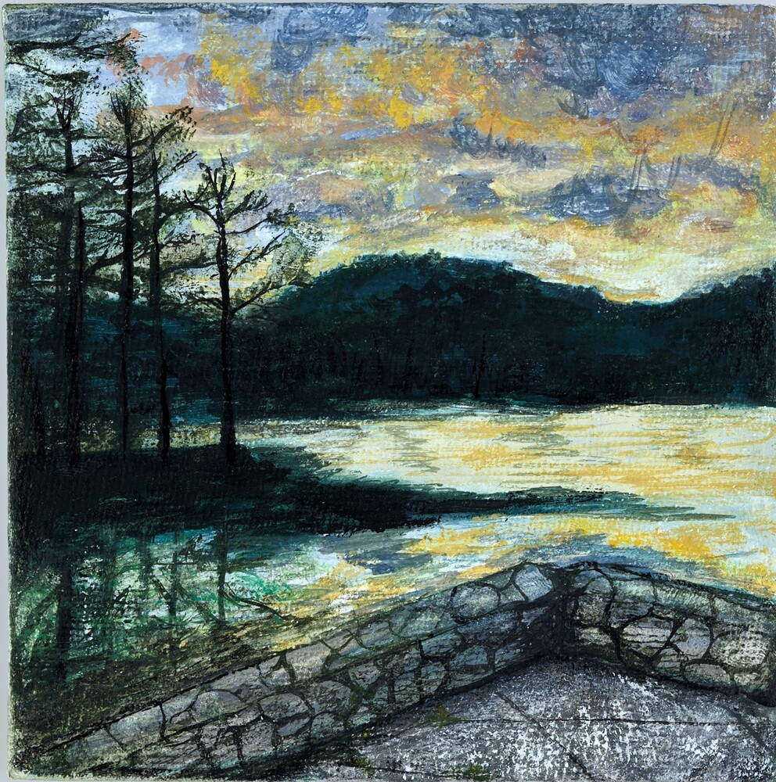
Army, Art, Archives: Archival Engagement and Outreach in an Academic Service Academy Library
Lori Mullooly
Events and Programming Librarian
Lisa Gomez
Exhibition Librarian
Jennifer Chess
Communications and Marketing Librarian
UNITED STATES MILITARY ACADEMY LIBRARY

Slide 3
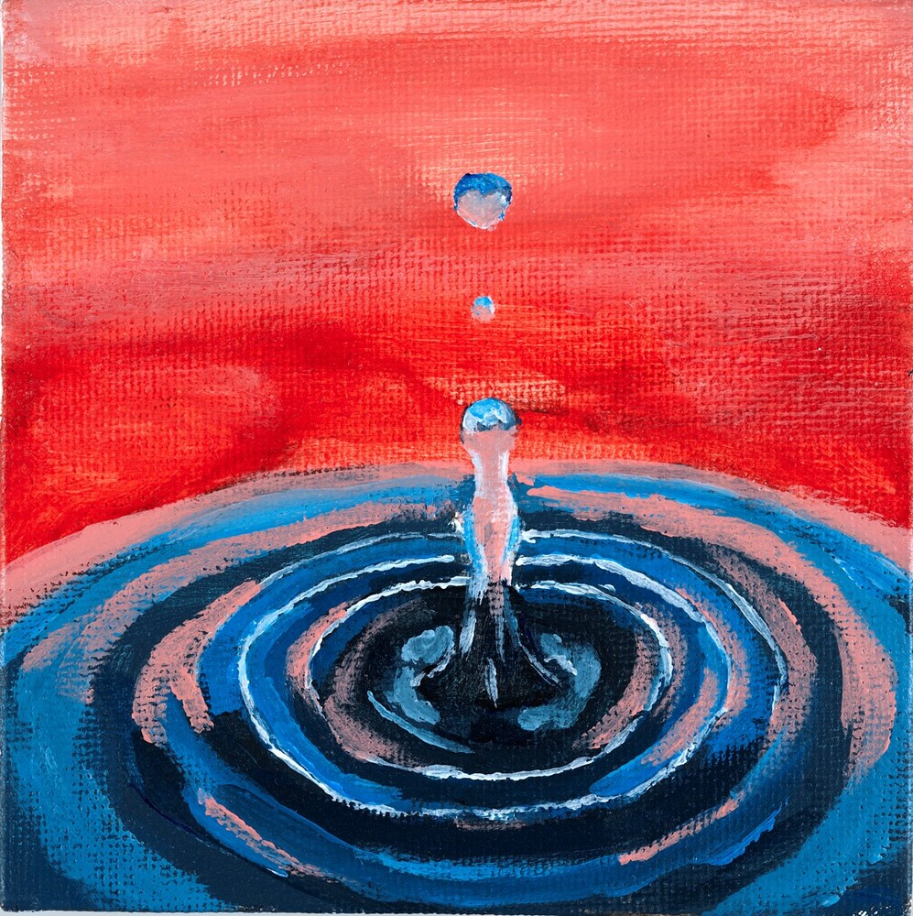
Agenda
Army, Art, Archives: Archival Engagement and Outreach in an Academic Service Academy Library
Overview of Program
Physical & Digital Exhibits
Marketing
Journey to the Archives

Slide 4
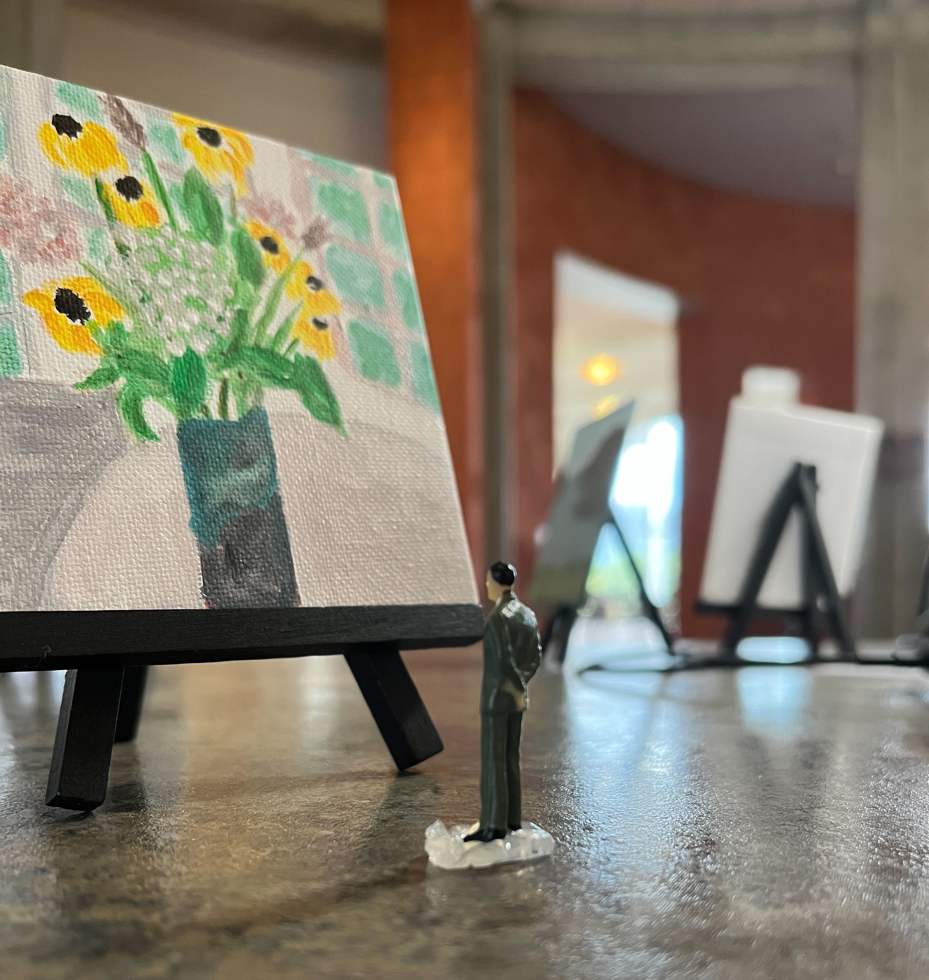
The United States Military Academy Library has been working hard to increase outreach to our community. We are specifically interested in our students’ engagement with our Archives and Special Collections materials, and we often discuss as an institution the importance of capturing current cadet experience in multiple formats such as physical and born-digital materials. Therefore, a group of USMA Librarians created and executed a successful Tiny Art Program and Magnificent Miniatures Exhibition.
This presentation outlines how we combined academic library programming, exhibition, marketing, and digitization initiatives to inspire cadets to create original art that is inclusive of their experiences at West Point.
These works of original art and images will serve as unique holdings for future generations to study to understand what cadet life at West Point was like in 2022.
The massive success of the Tiny Art Program and the Magnificent Miniatures Exhibition has allowed us to increase awareness of both the USMA Library and our Archives and Special Collections on campus and beyond.
This awareness has led to new collaborations that have strengthened library relationships across the West Point community. Also, we created digital replicas of the artwork for our manuscript holdings that represent our diverse student body and the Army.
This program will allow us to advocate for further access and outreach initiatives.

Slide 5

Goals
Mission Statement and
Long Range Plans
Library Collection and Services
Passive Program
Outreach
Archival Engagement and Scholarly Output

Slide 6

Magnificent Miniatures Tiny Art Show

Slide 7
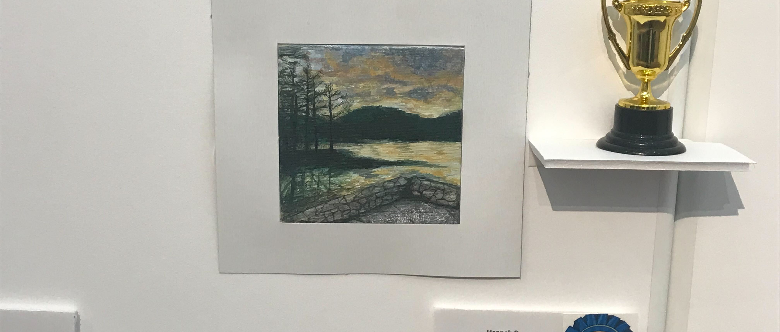
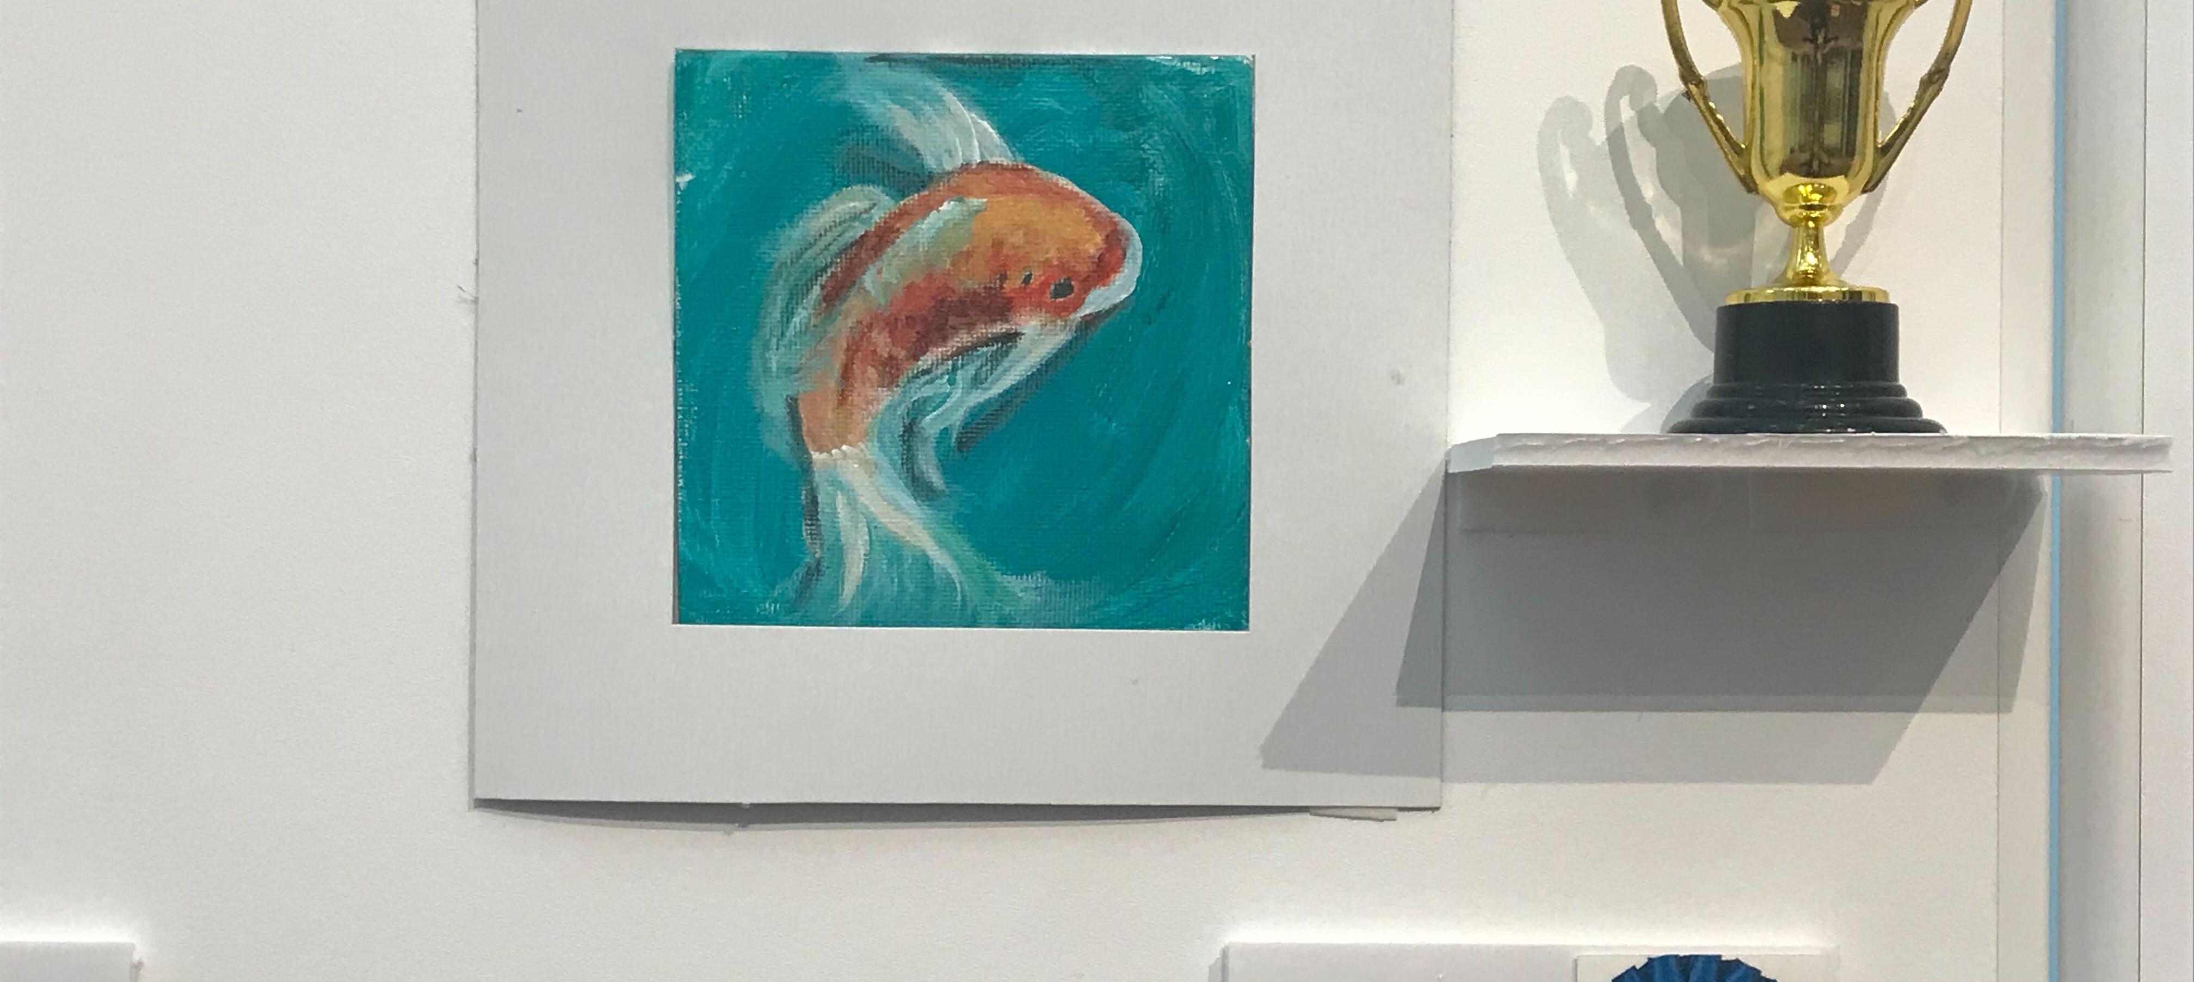
A unique challenge for archivists and librarians is to provide programs and outreach to patrons that are heavily scheduled or have an intense workload. Passive programming is one approach. This presentation illustrates one highly successful passive initiative. The United States Military Academy Library’s passive Tiny Art program “Magnificent Miniatures” resulted in 95 canvases of original cadet artwork. These canvases were used to produce a major art exhibit, which was so popular that it was then digitized. Passive programming, such as Tiny Art, results in active learning that is self-paced and self-directed. This eliminates the time and scheduling barriers (for both library staff and patrons) and creates opportunities for patrons to interact with library staff and resources as their schedule allows. Passive programs are budget-friendly and can be used year after year.

Slide 8
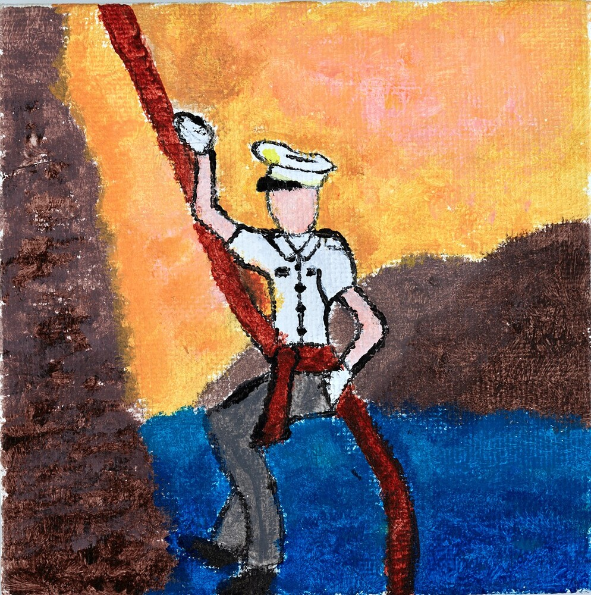
Overcoming Silos
Leverage Relationships
Organizational Buy In

Slide 9
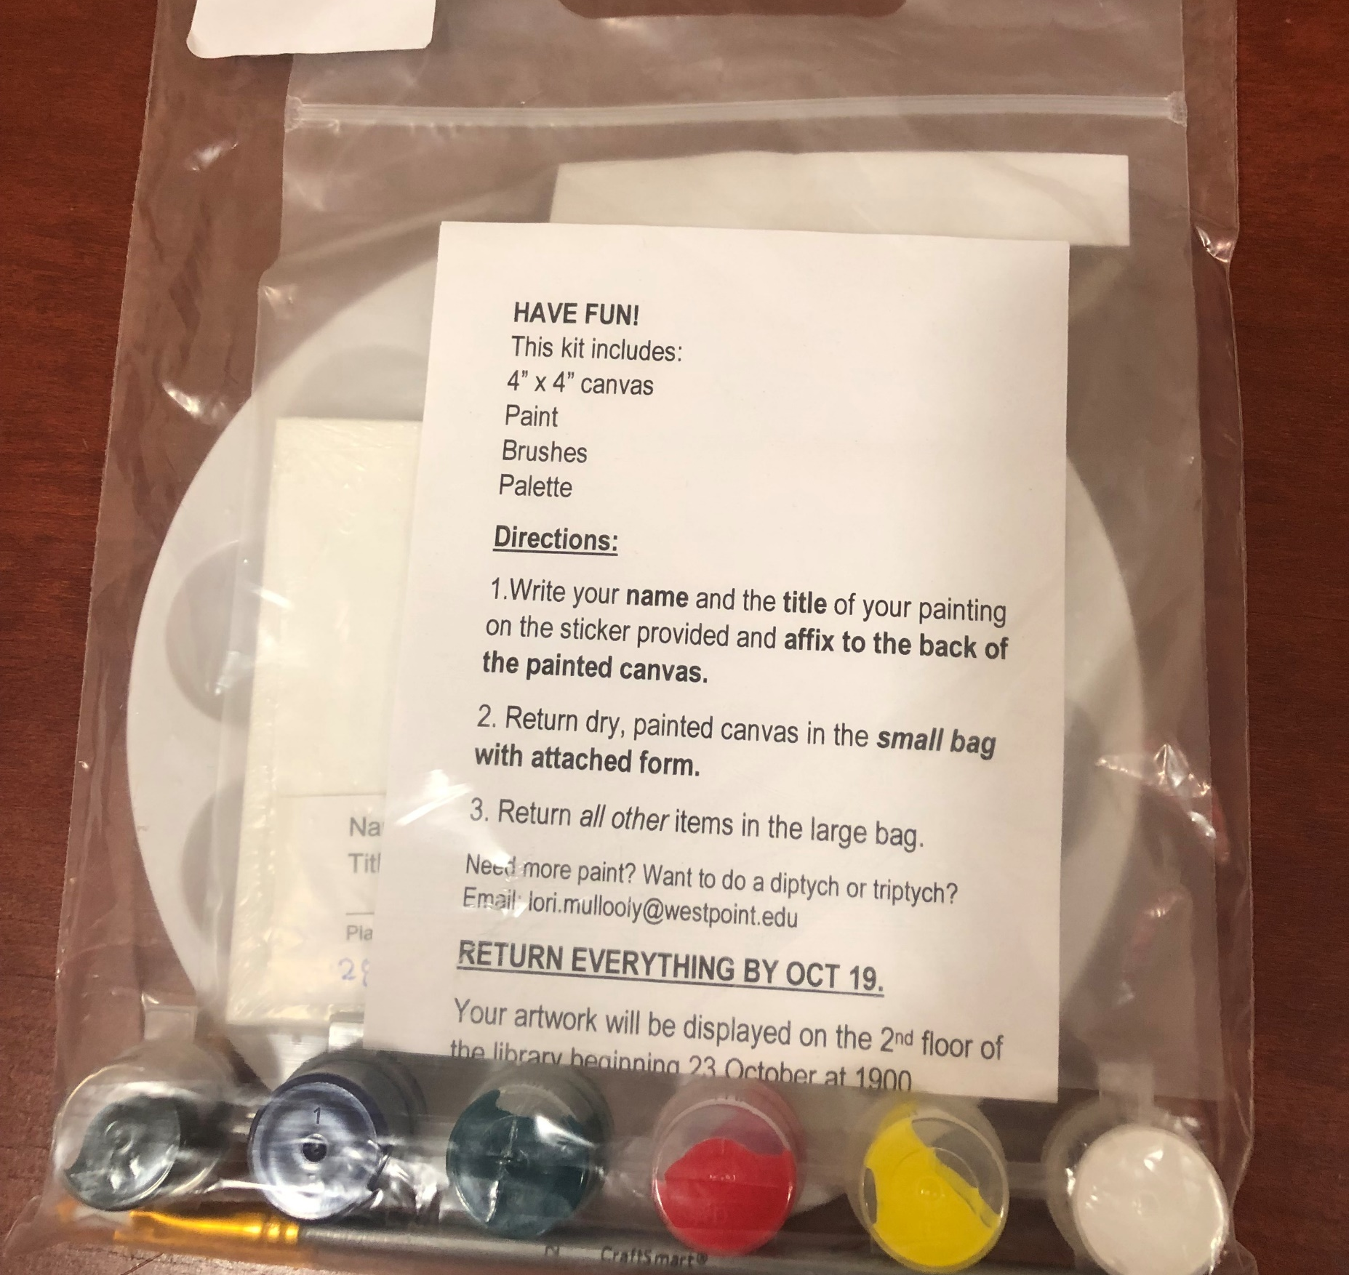
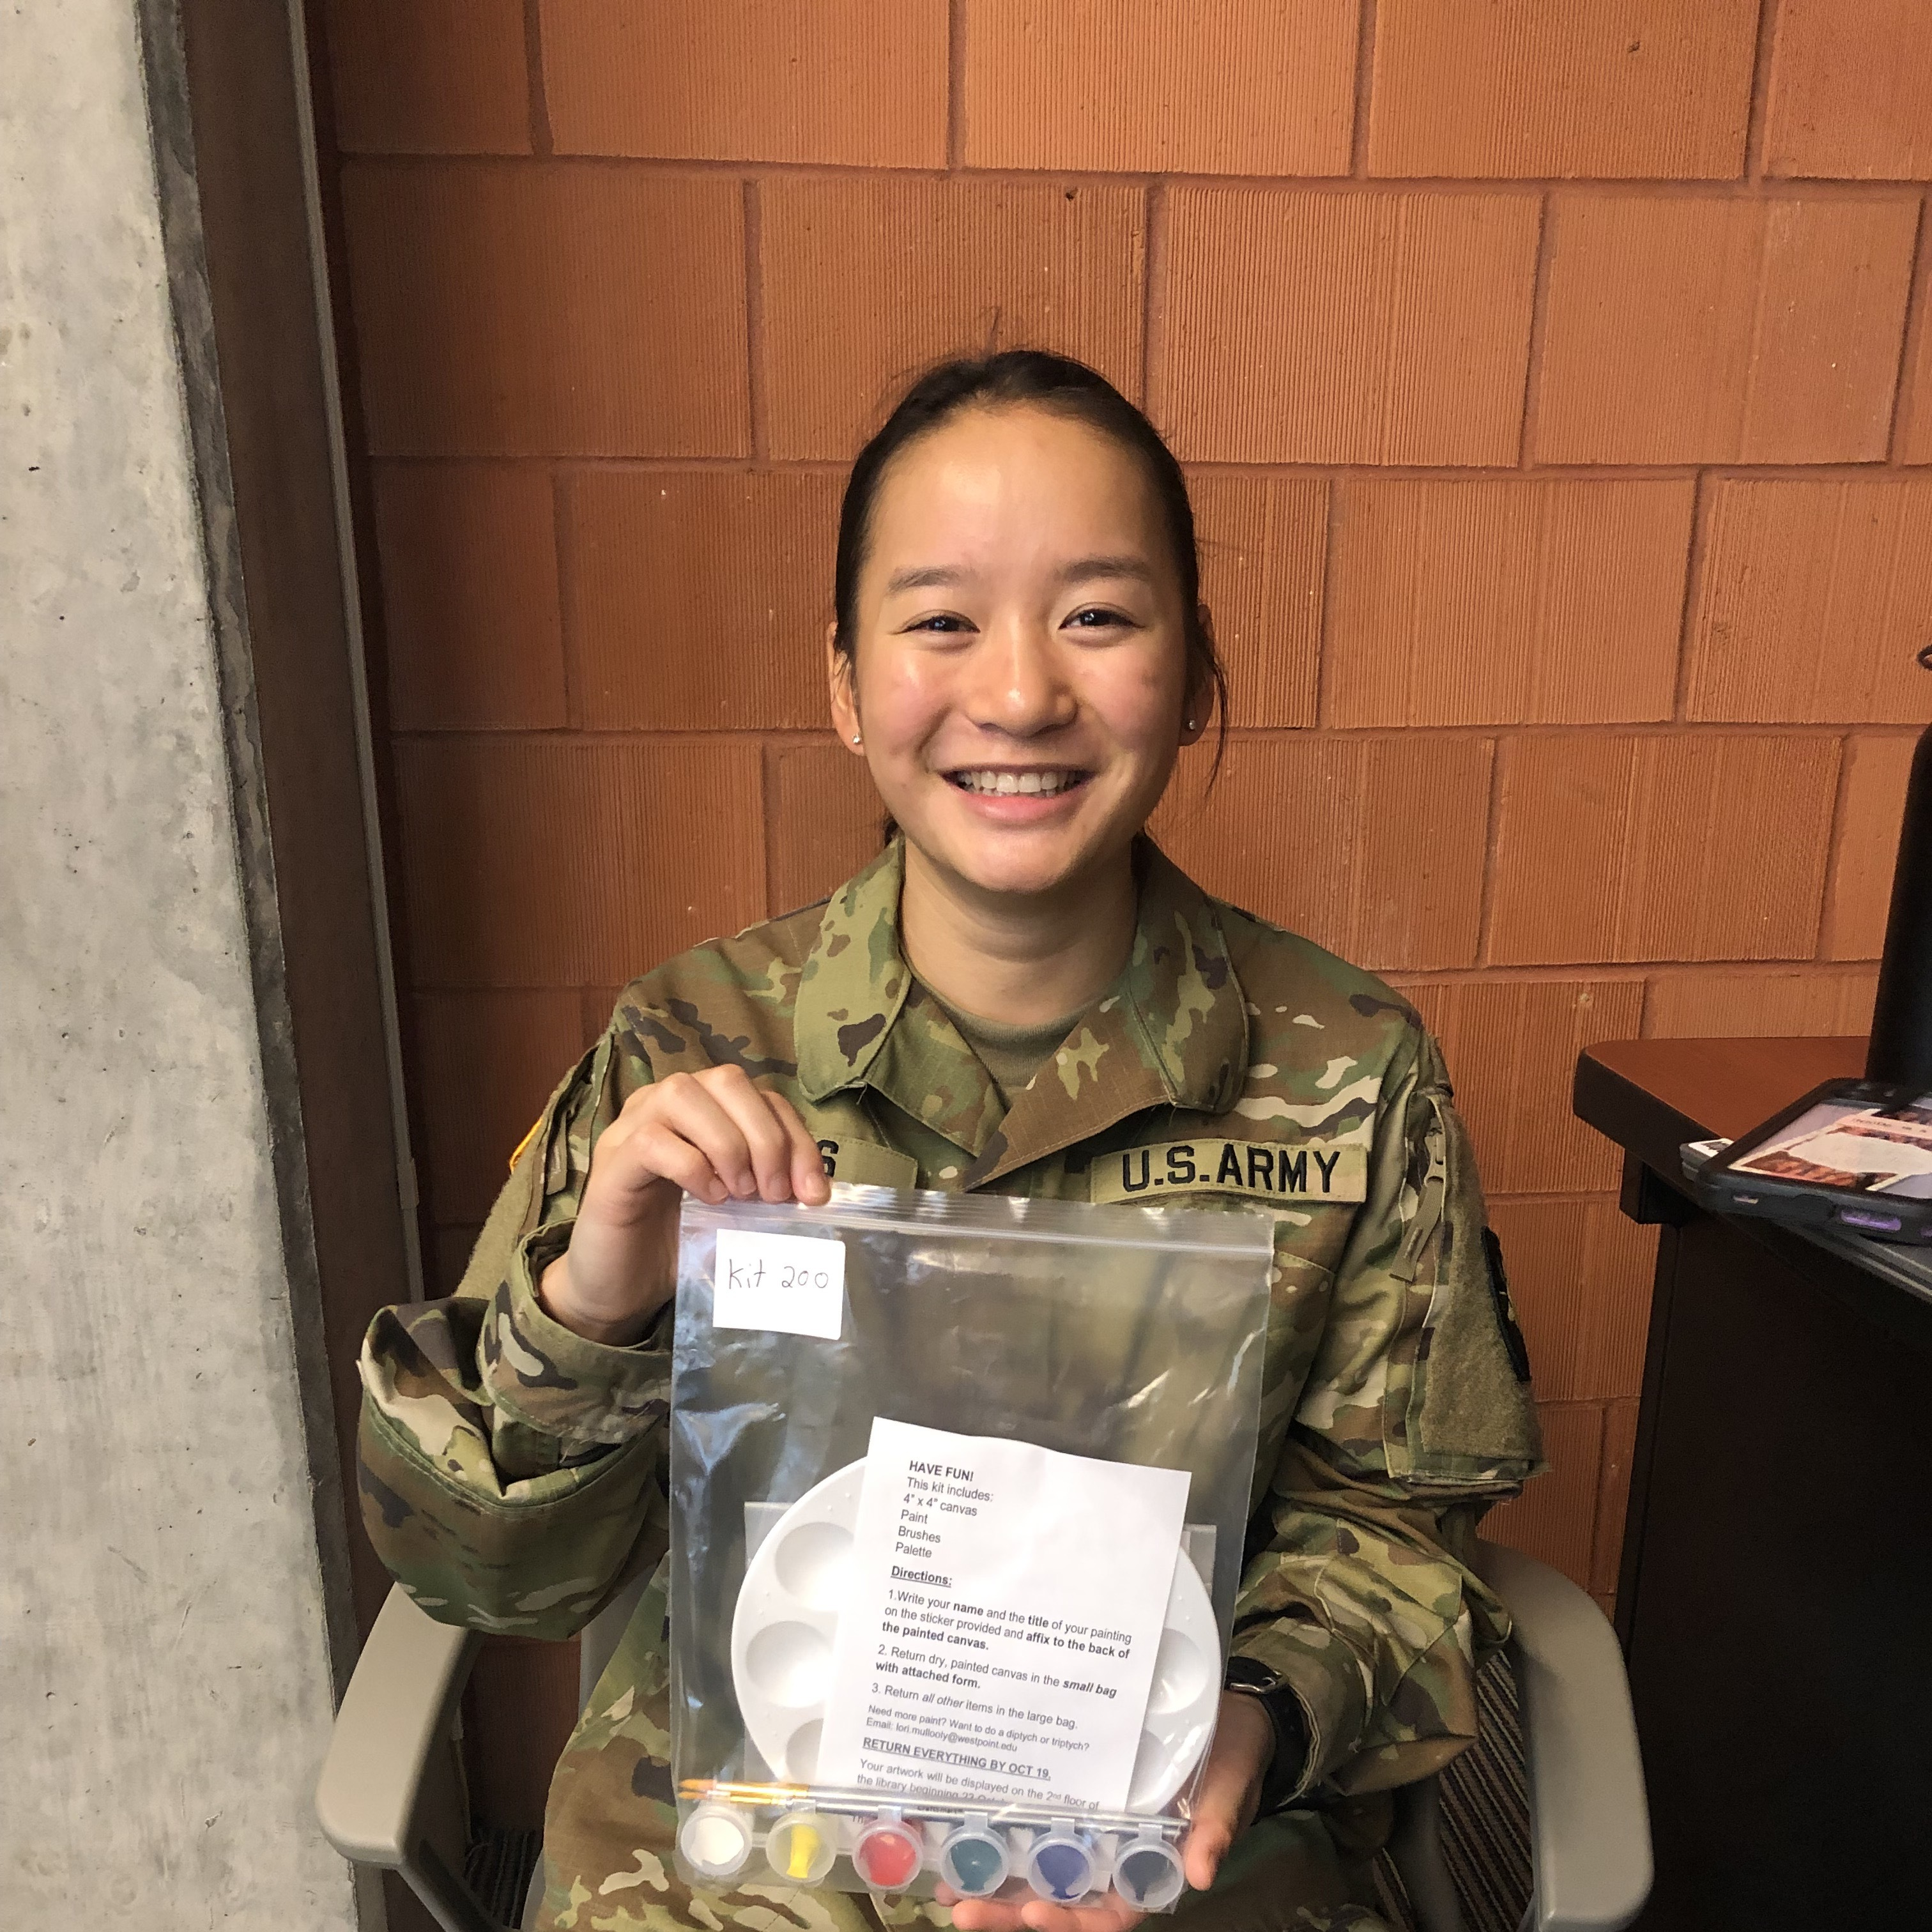
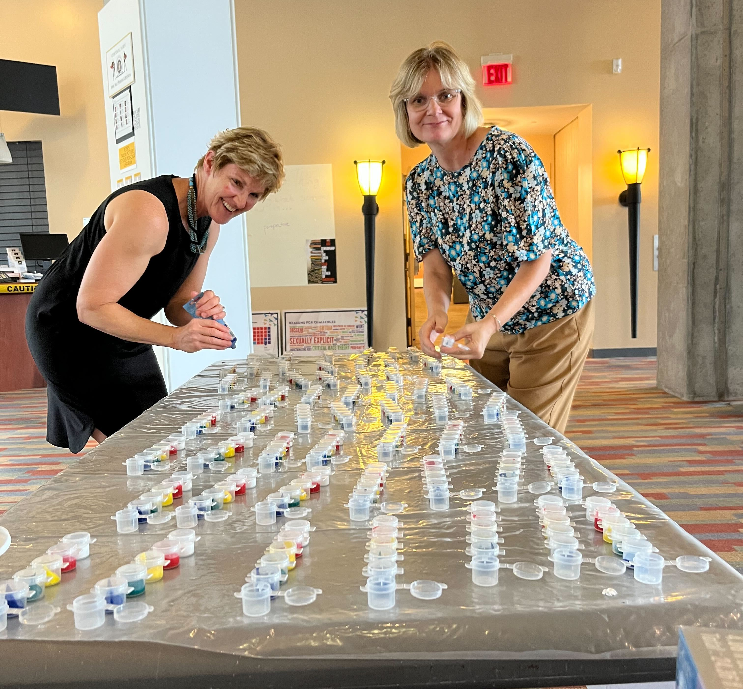
Executing the Program:
Why Tiny Art?
Army, Art, Archives: Archival Engagement and Outreach in an Academic Service Academy Library
•“Magnificent Miniatures” speaks directly to the USMA Library Mission Statement, which charges us to make the library a place to engage with knowledge and ideas
•Creating an exhibit from original cadet artwork allowed cadets to engage with the exhibit (both at the library and virtually), the library collection, and each other. Setting up voting made the program interactive and led to a greater appreciation of the art.
•This is an application of scholarly information. Artistic creation is a creative problem process, including skills such as critical thinking, analysis, investigation, and innovation. Creating artwork allowed our cadets to produce original works of scholarship and be part of the scholarly conversation.

Slide 10
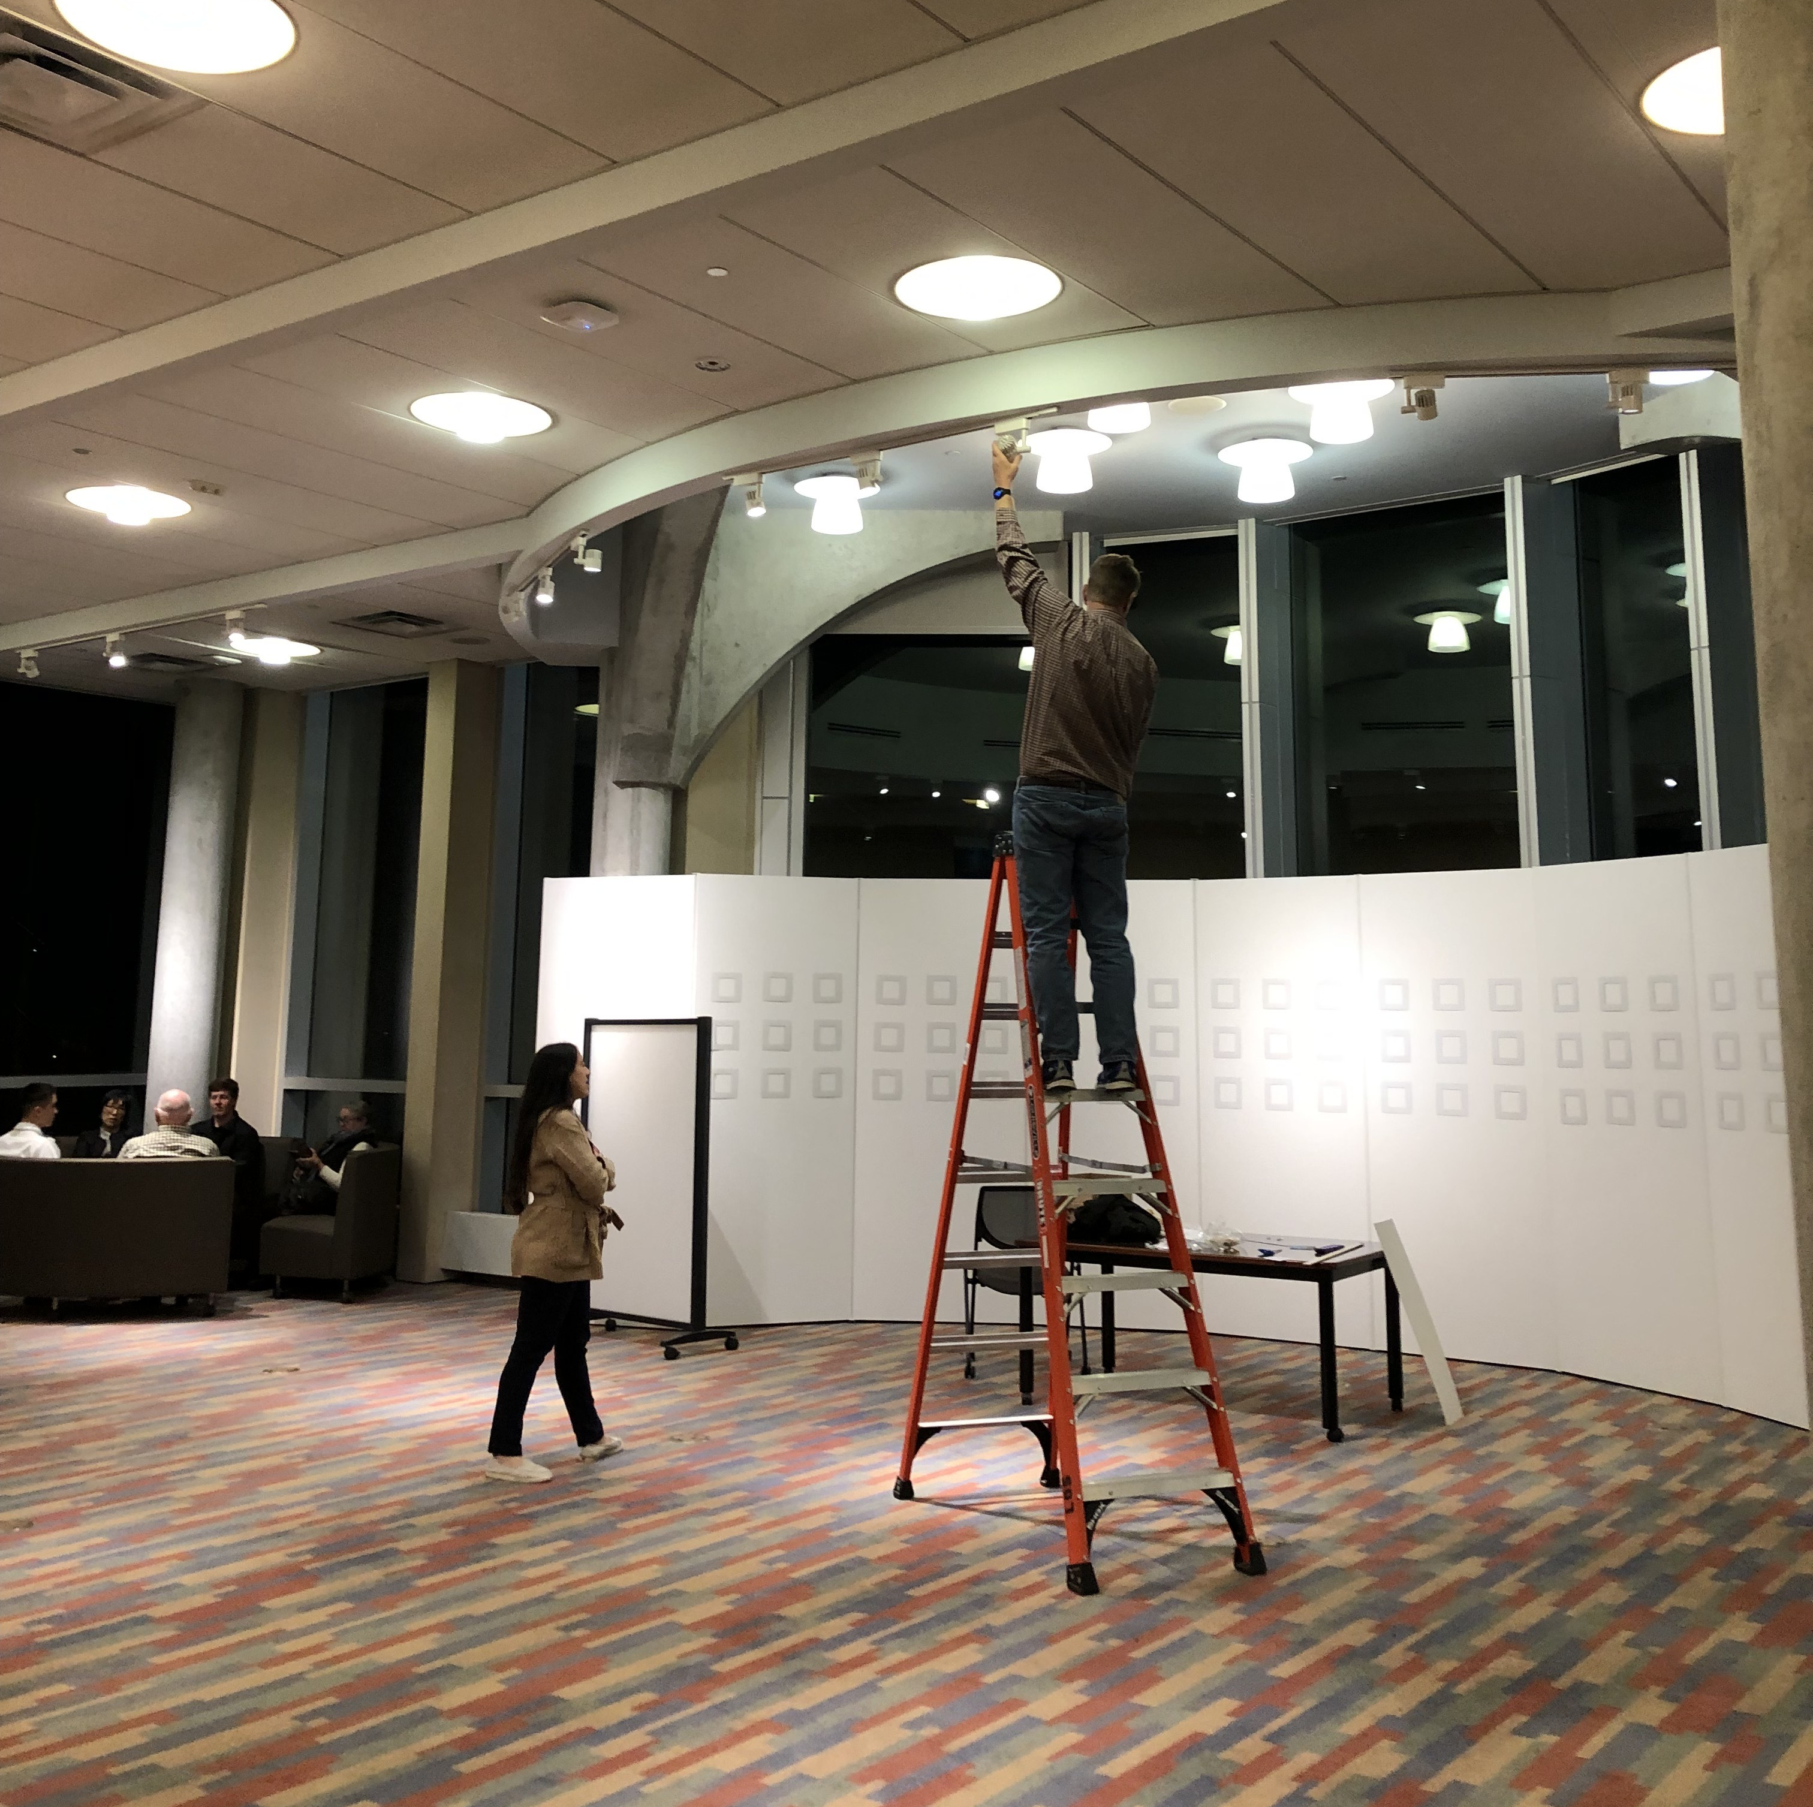
Magnificent Miniatures Exhibition:
Project Planning
Create Project Timeline: Aim to understand your audience and what they want from their viewing experience, and you plan your pre-installation to post-installation project timeline
Securing Venue/Space: Consider security, light, accessibility, and functionality
Galvanizing Staff: Tap into specific staff talents and be mindful of popular vacation time for staff availability as well as simultaneous events happening on campus

Slide 11
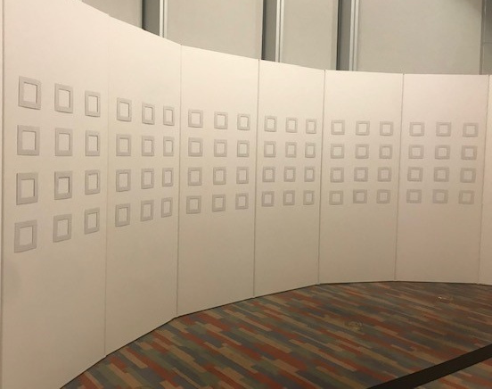
Magnificent Miniatures Exhibition-Installation
As library professionals, we aim to share our holdings dynamically, particularly exhibit development. Art can be an expression of experience, and by participating in this program, cadets conveyed their individual voices within the broader story of life at West Point. Next, as exhibit designers, we could tap into our creativity, aesthetic sensibilities, and orientation as we chose label templates, typeface, selected spaces, and applied considerations of accessibility, shape, size, and color when arranging works into eye-catching groups that featured a particular subject. From there, our audience could decide for themselves how each piece fits into the larger framework of the exhibition.

Slide 12
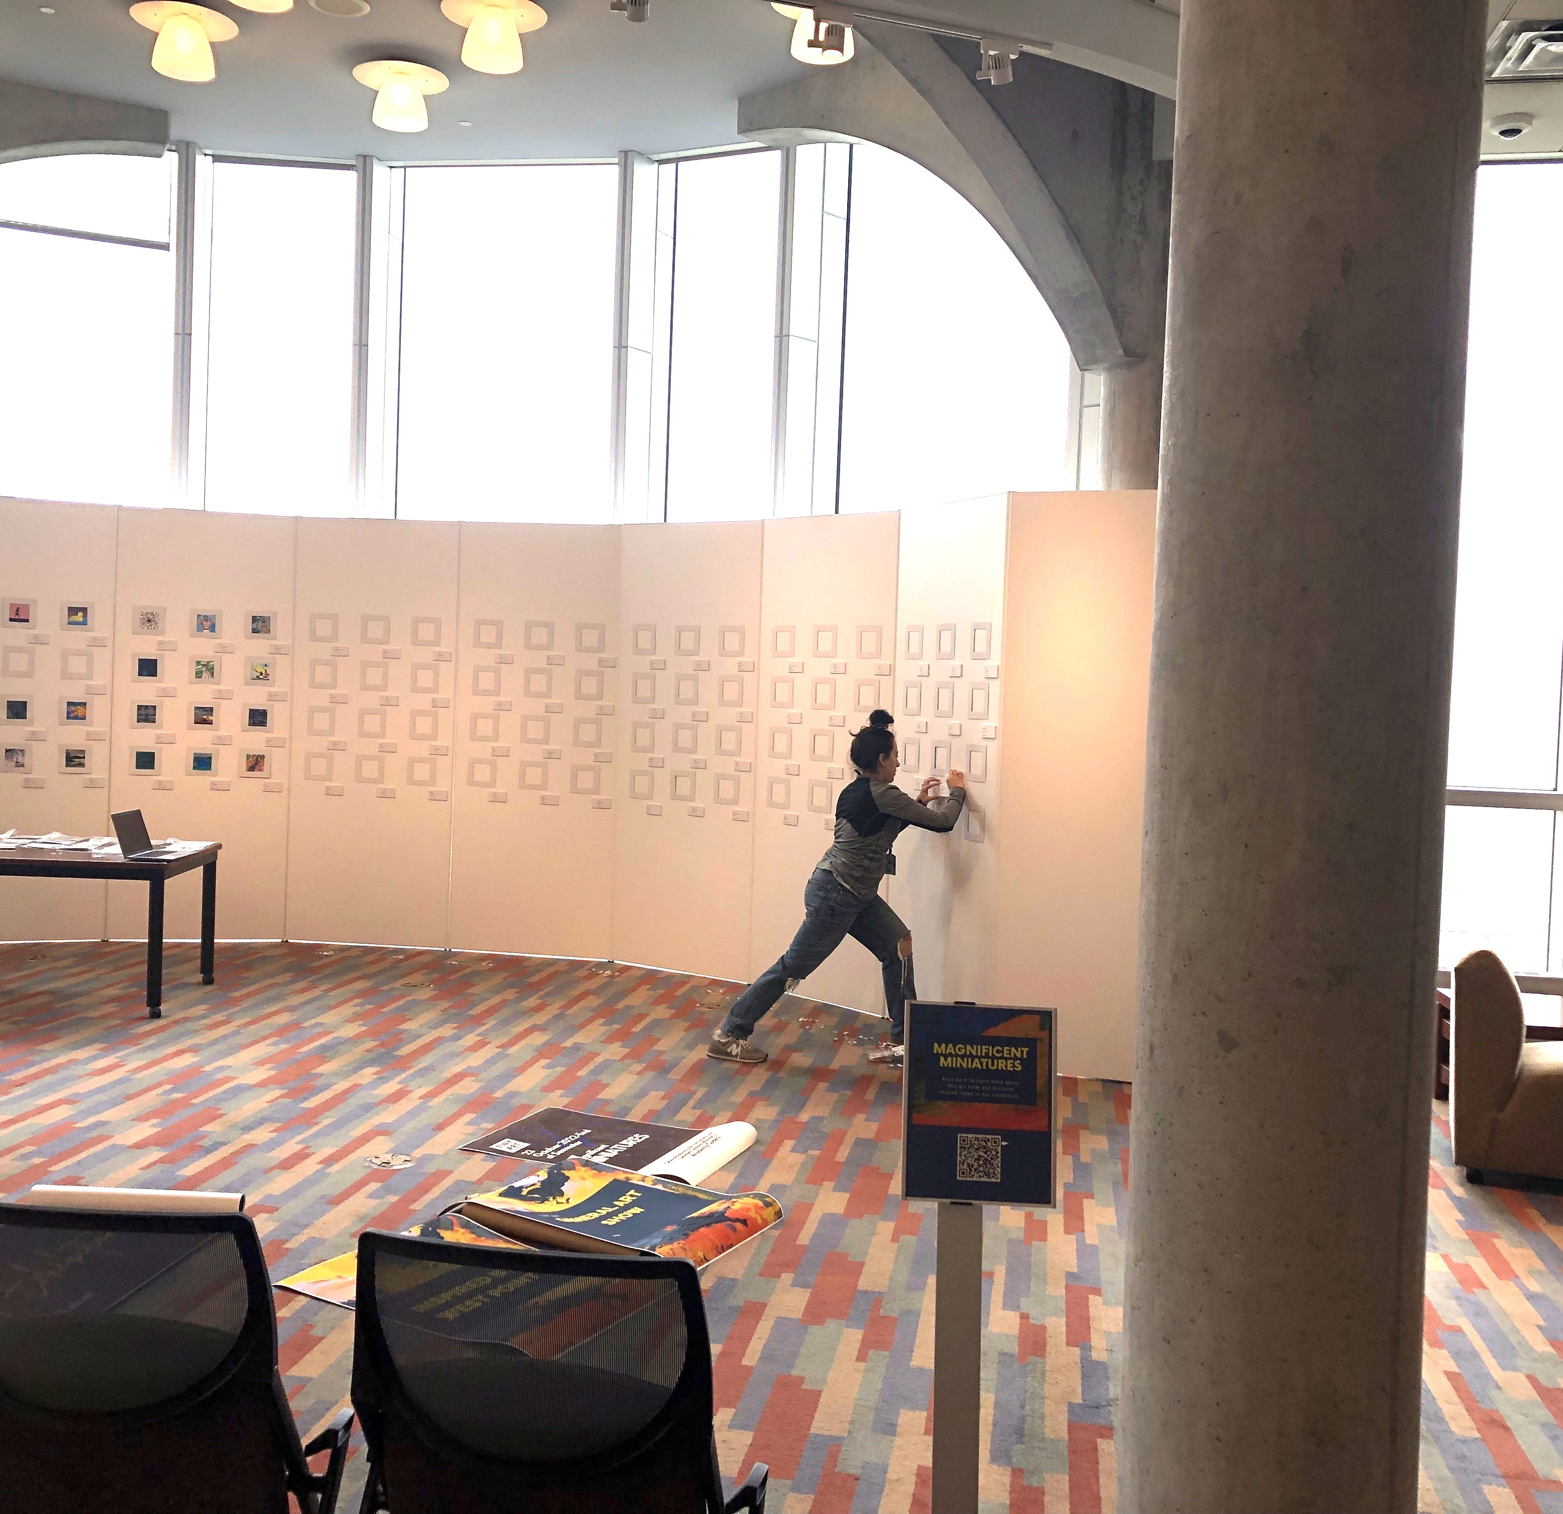
Magnificent Miniatures Exhibition-Installation
Materials Needed: Command Strips, Cardboard Frames, Art Panels, Matboard for Labels
Spatial Planning: Choosing a design that can accommodate a myriad number of returned canvases while also remaining cognizant of security, lighting, accessibility, and functionality
Template and Labels: Design considerations Museum Style Vs. Salon Style; Grouping, arranging works into eye catching groups that feature a subject or theme or related image; Template for hanging canvases and create art labels as canvases are submitted

Slide 13
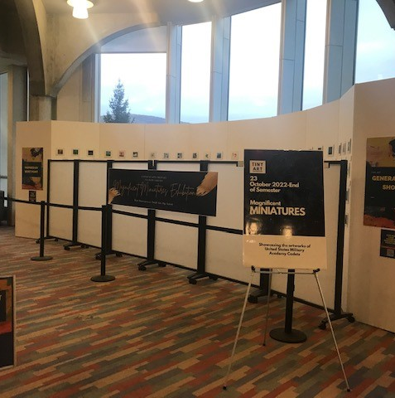
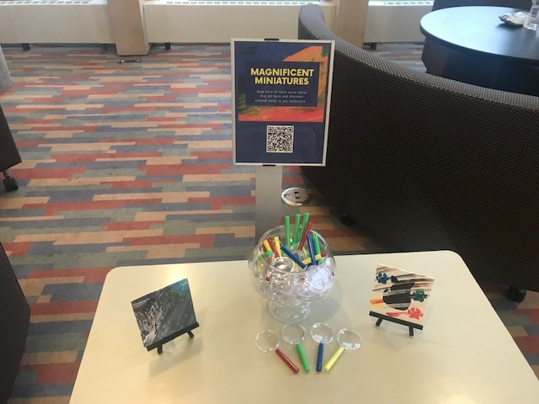
Magnificent Miniatures Exhibition-Installation
Post Installation Plan/Engagement with Patrons: Consider an opening event unveiling the exhibit; invite VIP members of the community
Assessment: Consider different assessment options to gather as much knowledge and information as possible regarding visitors' behavior, reactions, and comments

Slide 14
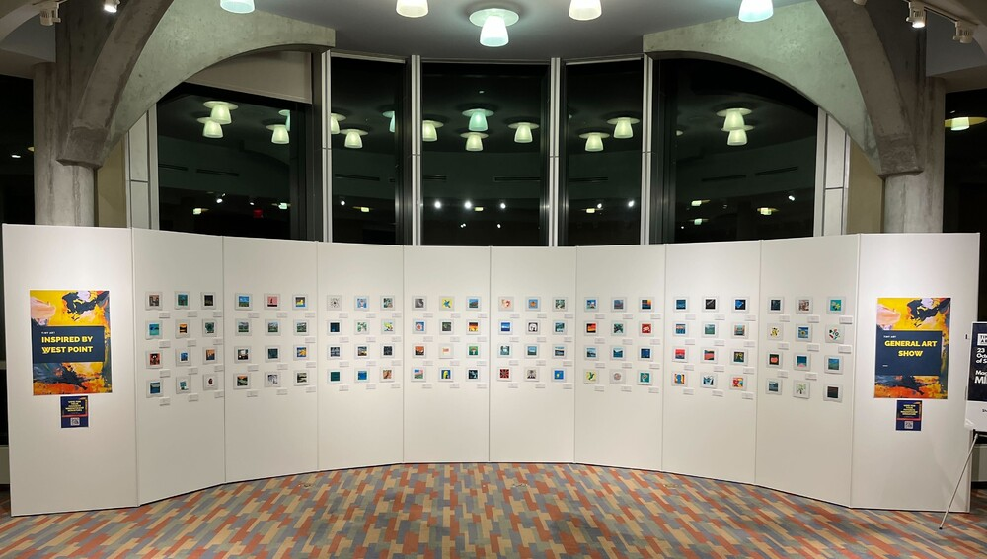

Slide 15
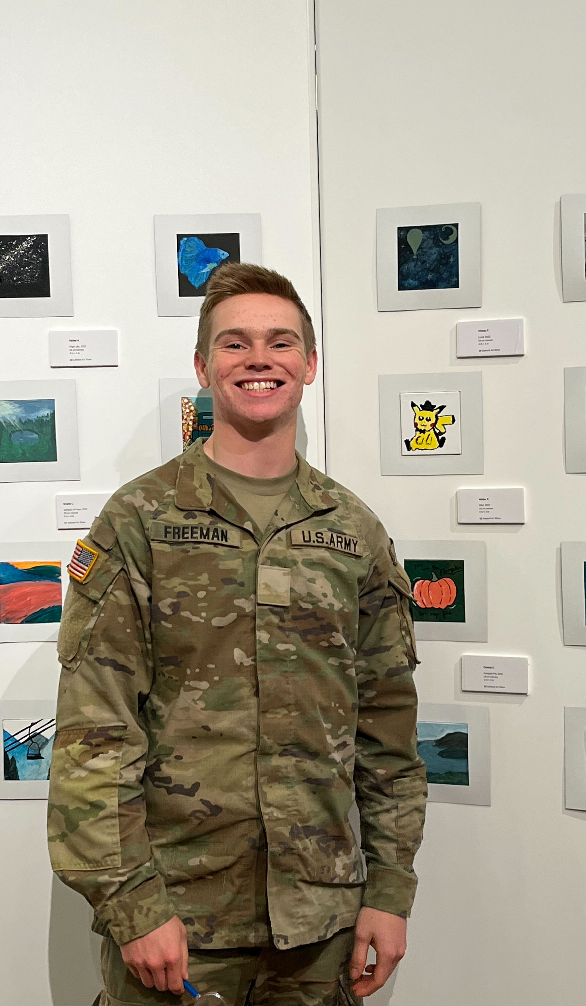
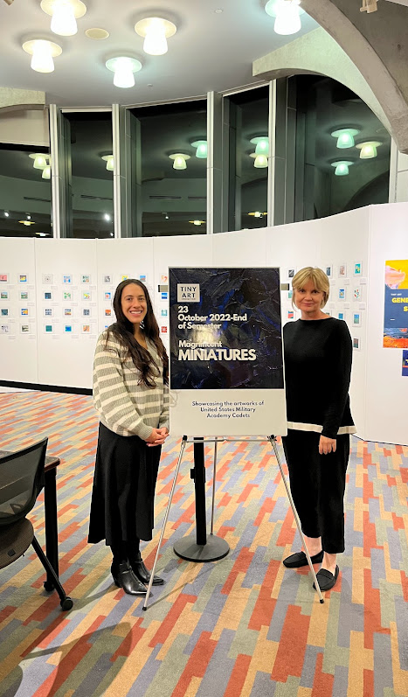
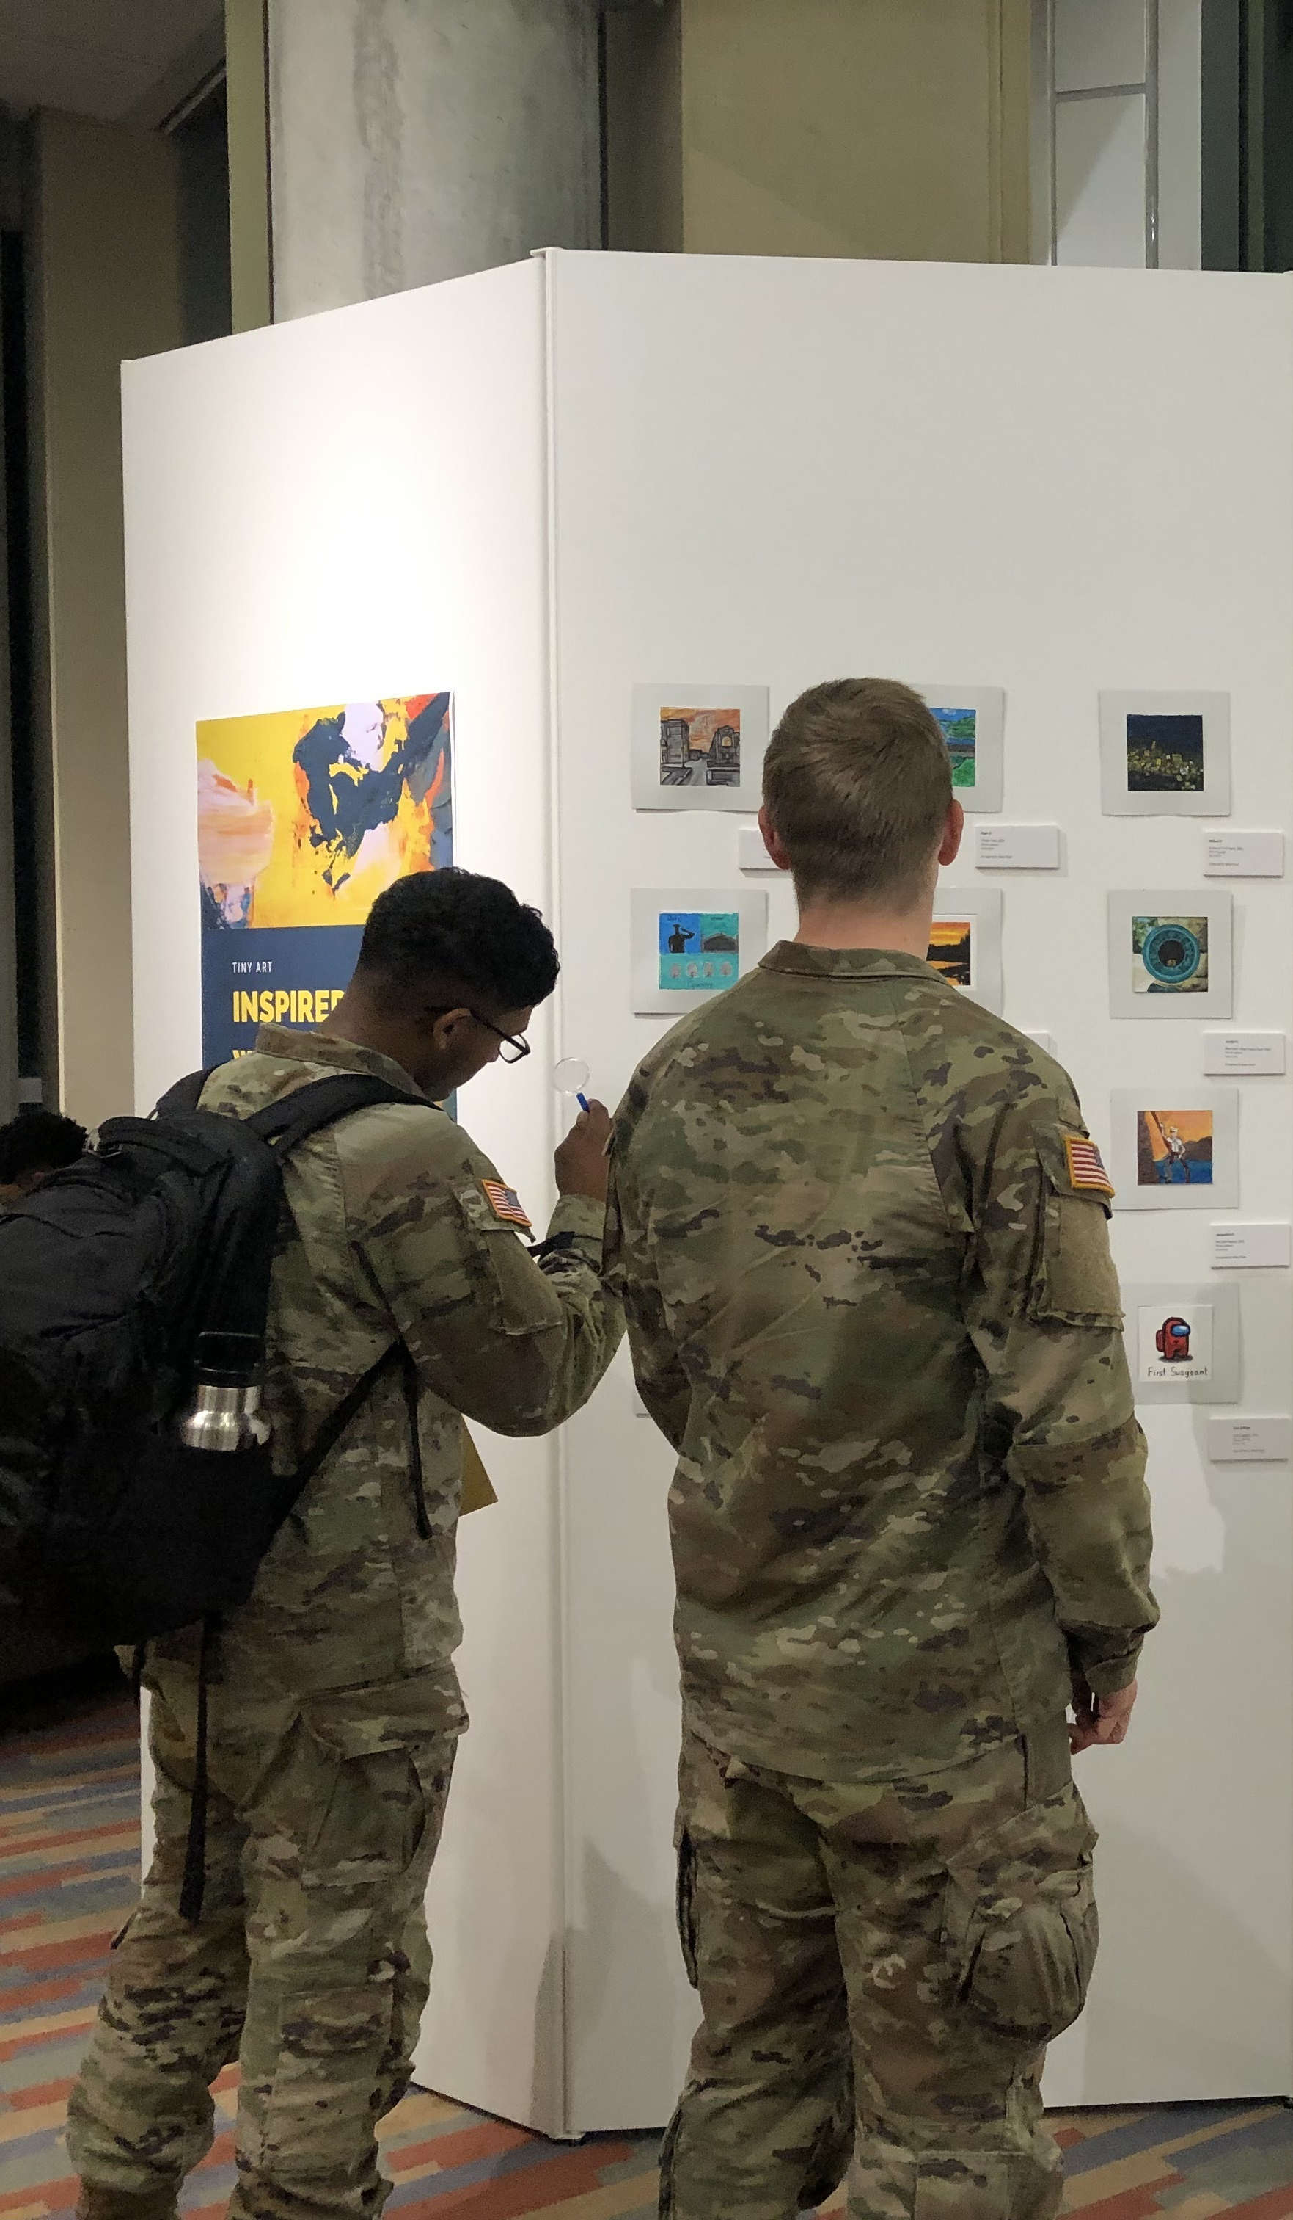

Slide 16

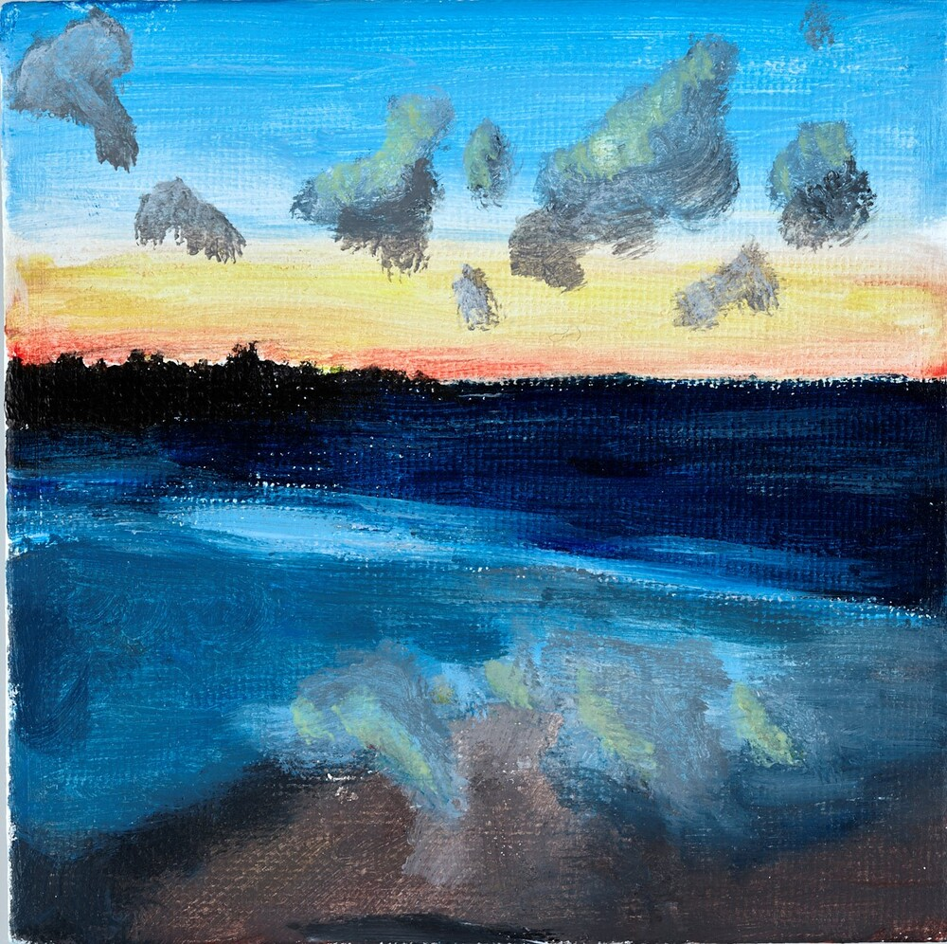
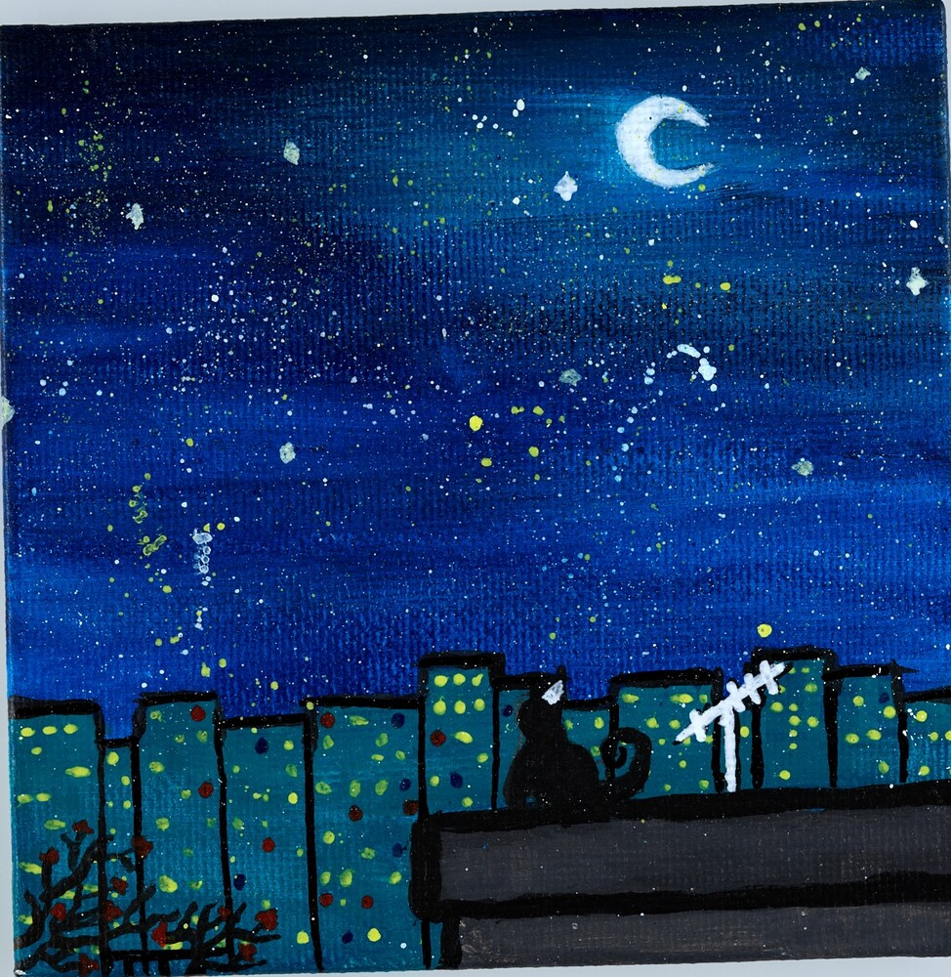

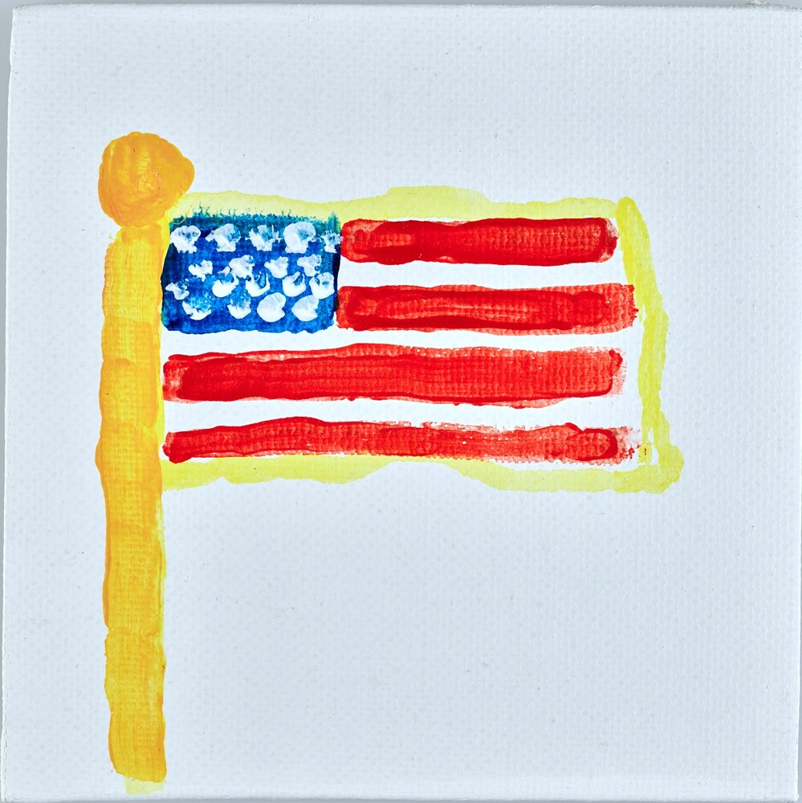
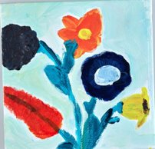
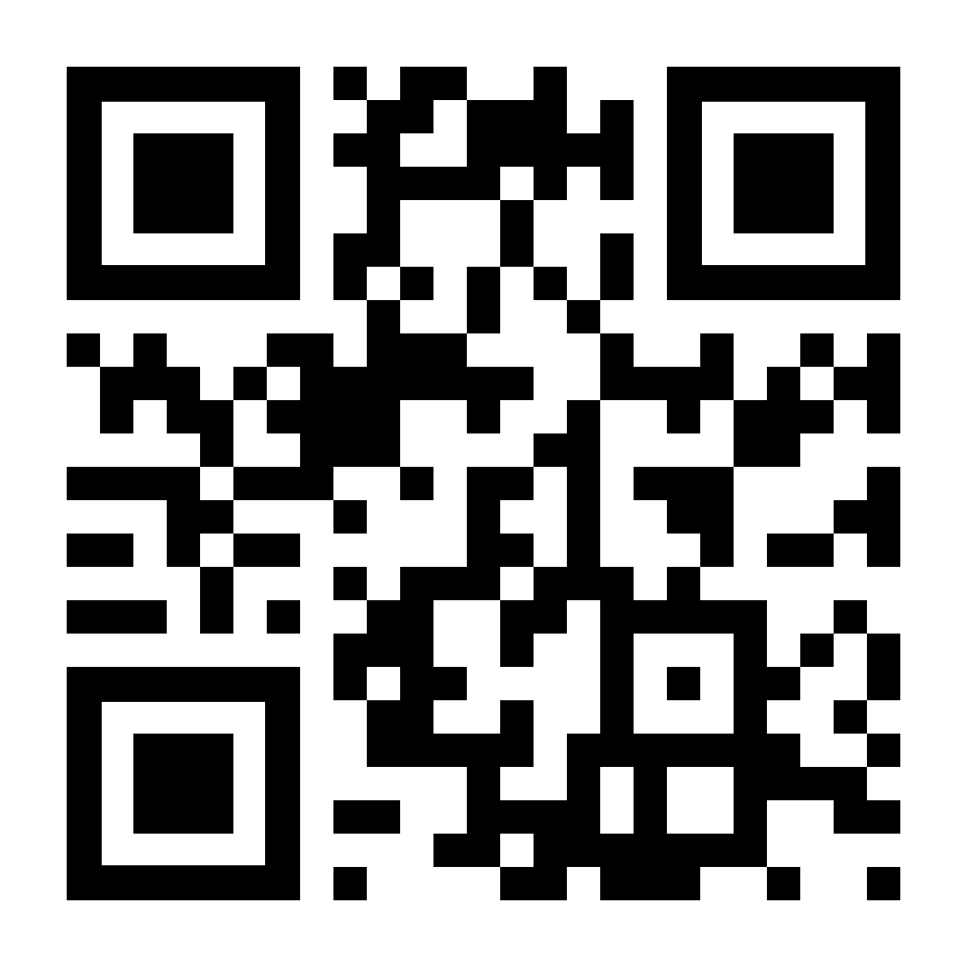
Magnificent Exhibition: Digital
Used this opportunity to digitize the tiny Art for future inclusion as a new series in USMA Archives and Special Collections.
Utilized Omeka, a free, flexible, and open-source web-publishing platform for displaying libraries, museums, archives, and scholarly collections and exhibitions.
Developed a digital exhibit that allowed us to share the artwork, history, and culture of West Point without limitations of time or location and encouraged community connection through Art.
http://bit.ly/3KqnRoE
Notes:
http://bit.ly/3KqnRoE

Slide 17
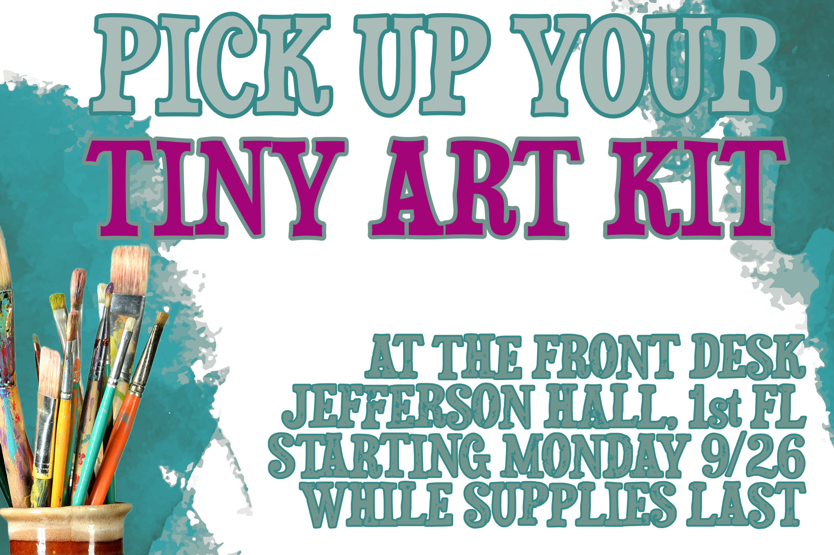

Slide 18
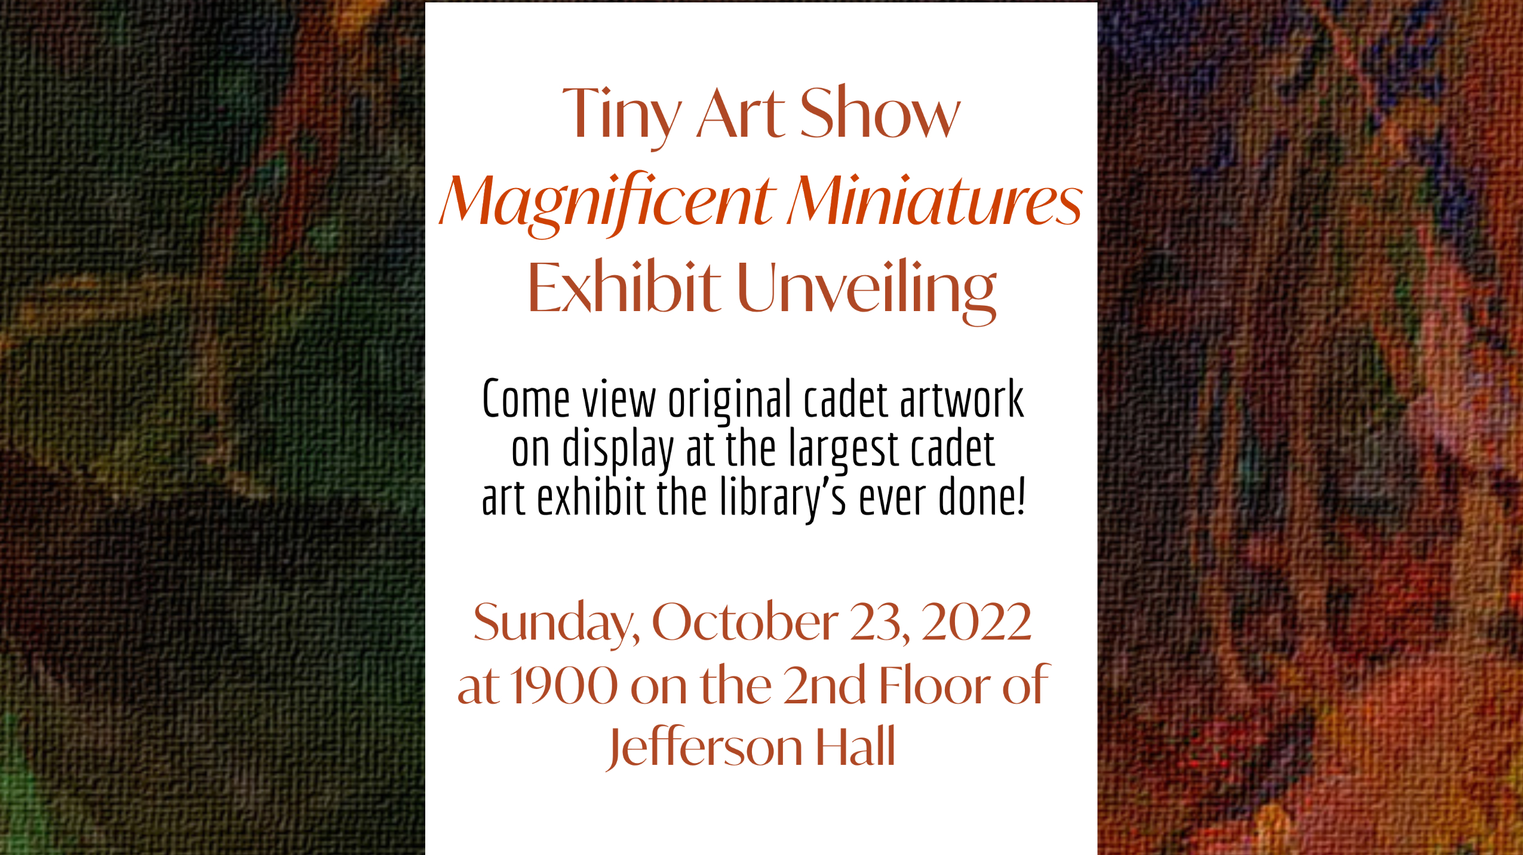

Slide 19

Notes:
And marketing on the digital exhibit

Slide 20
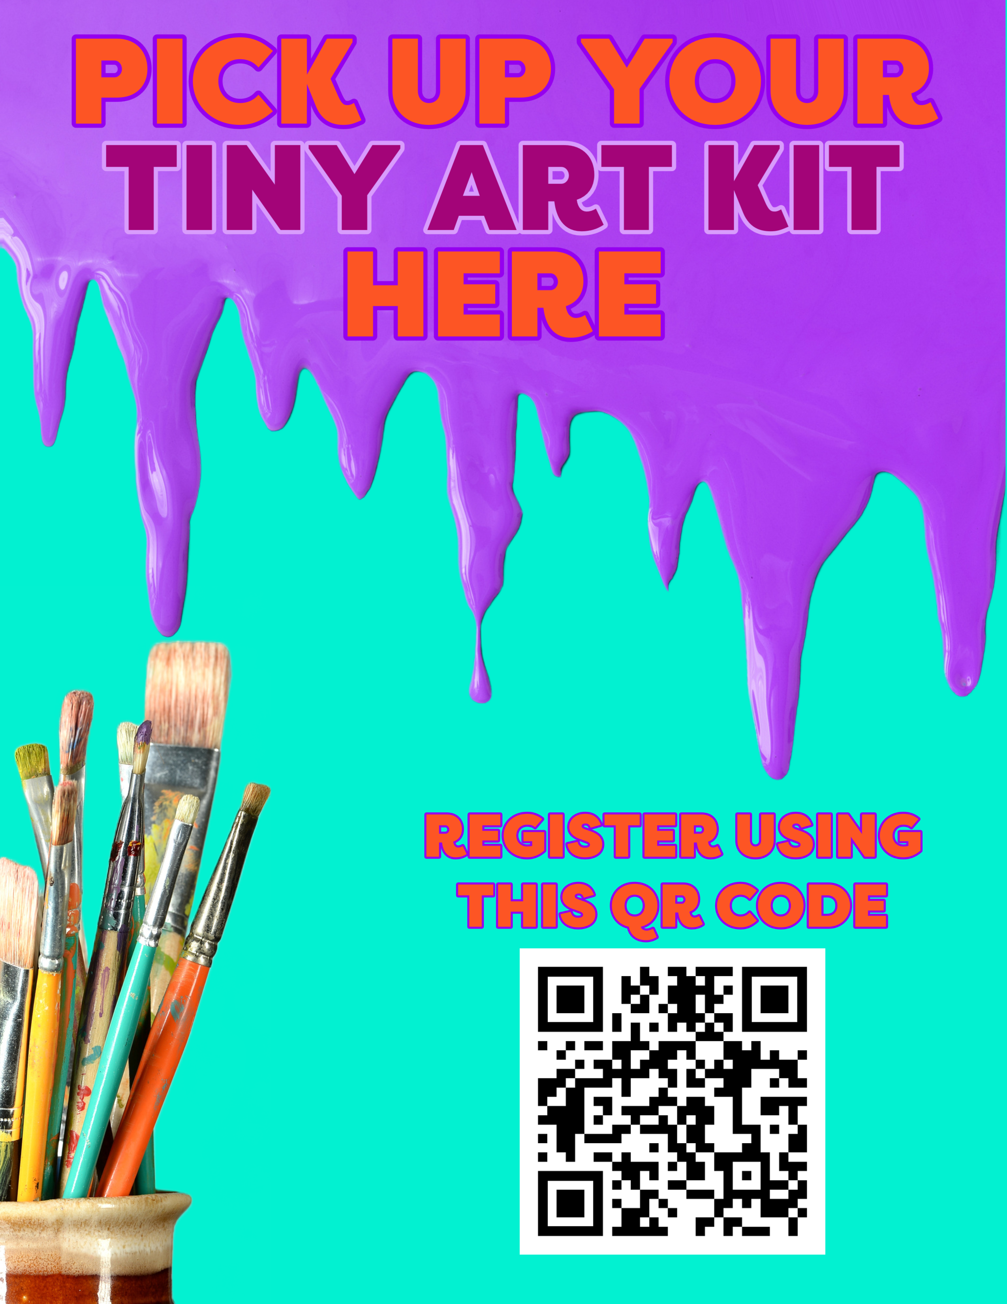
Marketing Channels: 3 Phases
Digital Signage:
Start a buzz and leverage word of mouth
Build relationships with other organizations and collaborate to expand reach
Leverage those new relationships for further collaborations
Use a variety of different marketing channels for each of the 3 phases. We used most channels for all phases; some worked better for particular phases. We also ensured that each phase looked unique and different from the previous phase so that we could still stimulate interest. These channels included digital signage we posted on our website, internally in the library, and externally in the mess hall. Based on previous experimentation, we've learned that the mess hall is one of those unique opportunities because we have a captive audience. A slideshow plays on large screens while the cadets eat, so they often look at them if they want to avoid engaging with their peers while they eat. Building relationships with other organizations, even outside your library, can open the door for some of those opportunities and shed light on opportunities that you didn't know existed. For example, if you're targeting this program to teens, maybe a digital sign runs in the auditorium or hallway where they wait before school starts or in the cafeteria that you can utilize. Reaching out to the school librarian can open the door and shed light on valuable marketing efforts.

Slide 21
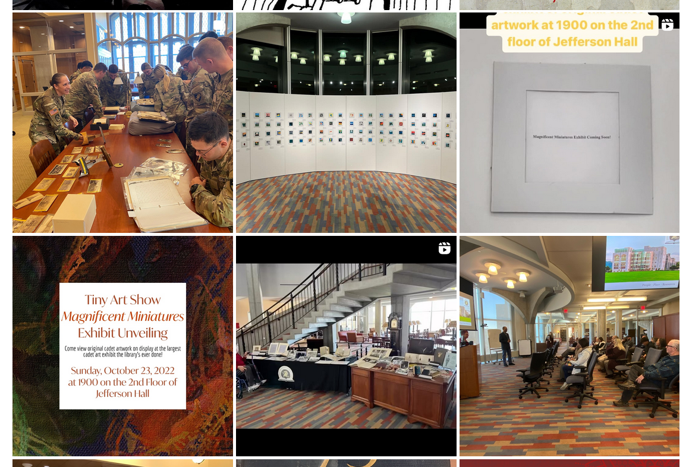
Marketing Channels
Social Media: Instagram and Facebook

Slide 22
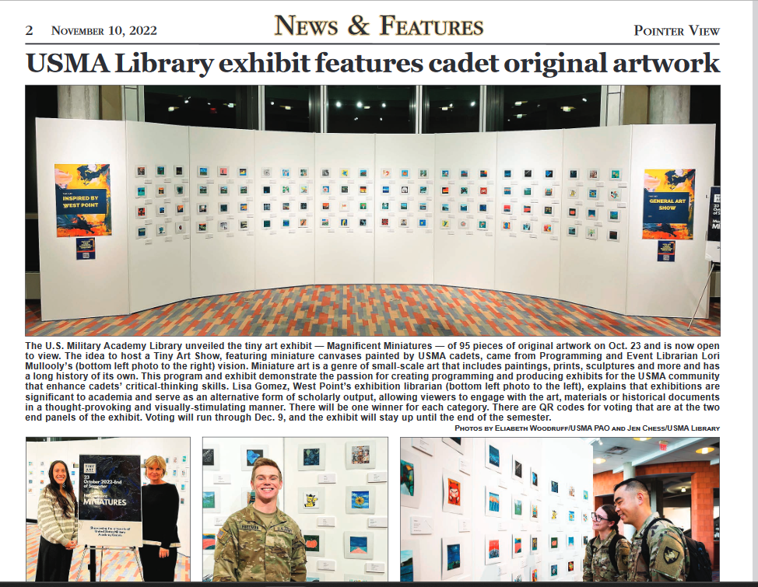
Marketing Channels
PAO- Pointer View & Social Media

Slide 23

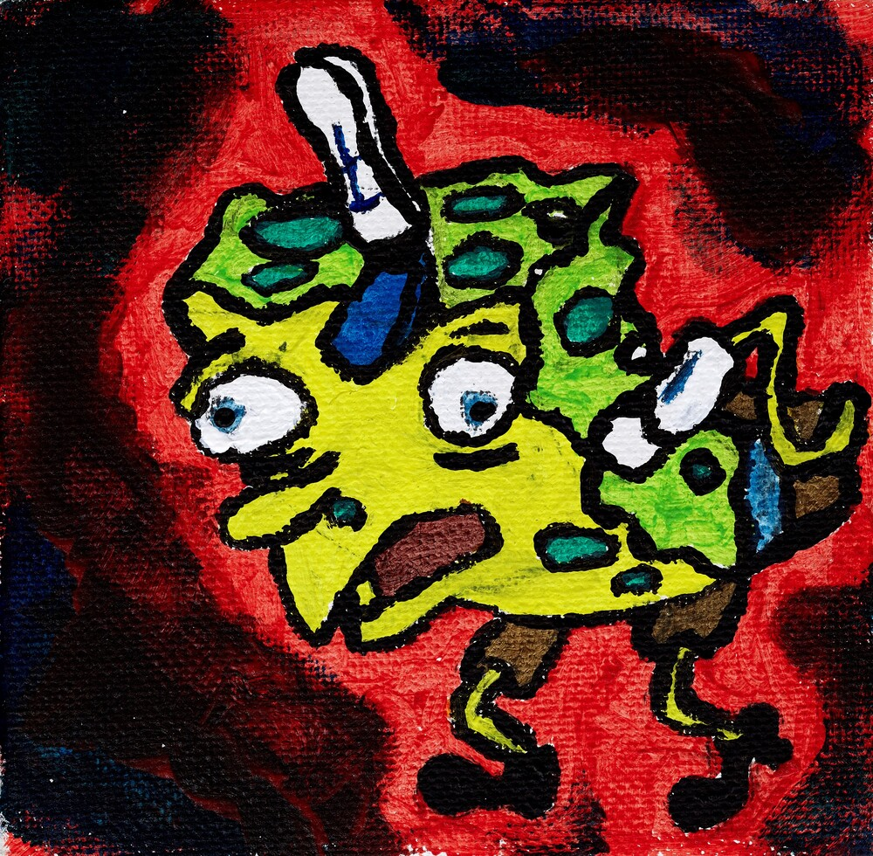

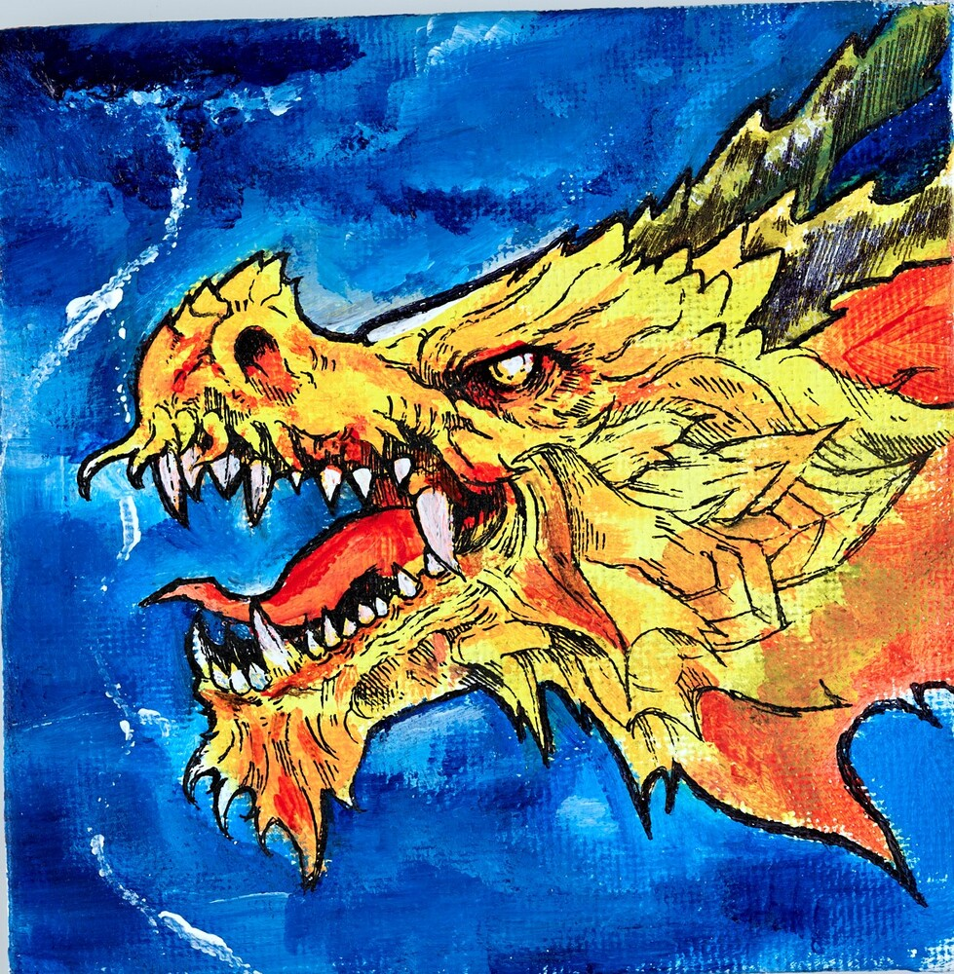
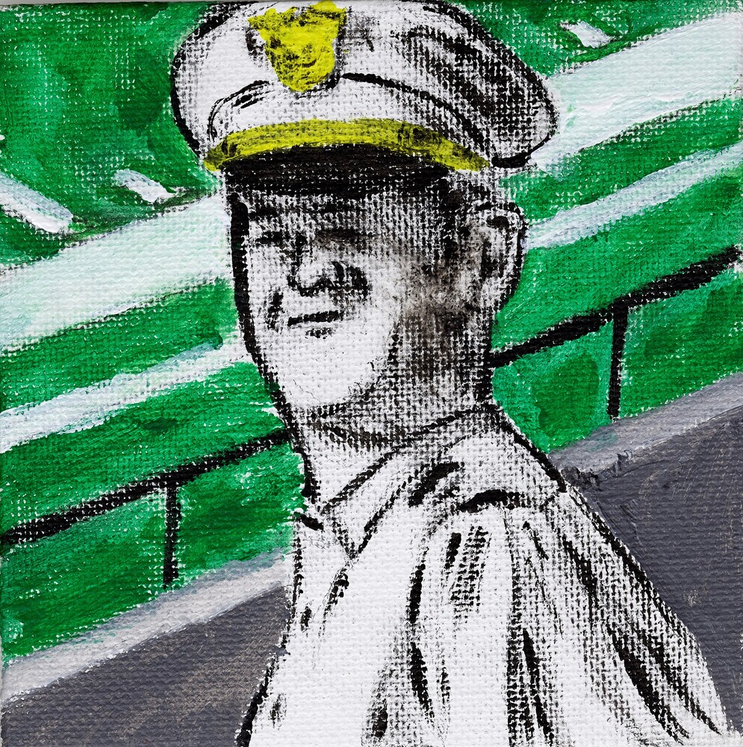

Marketing Channels
Word of Mouth

Slide 24

Lessons Learned
Participation rate: Your mileage may vary
Go with a theme
Timing matters
Collect good data
Don't be afraid to try something new and don't let perfectionism weigh you down
Again…PLAN EARLY!
Artist Statements/Incorporating technology mediums

Slide 25
Lessons Learned
Use program to raise awareness of library services, staff and collections.
We created a "Magnificent Miniatures“ LibGuide to connect patrons with resources within our collection about this unique art form. Staff made a point to engage with cadets, faculty and staff as they came to visit the exhibit.
Select a meaningful theme: We gave cadets the option to submit canvases that were “Inspired by West Point.” This spoke directly to the USMA Library’s strategic direction to “Inspire the Corps of Cadets.” This theme gave the program a much higher profile, drew the attention of many organizations on campus and beyond and ultimately gave the exhibit a more cohesive look. The theme also allows archivists the ability to make key decisions on accessioning the materials into our collections.
Leverage the high participation rate to obtain research data, but follow proper protocols
This program proved so popular, we soon realized there were enough participants to query for data that was representative of the entire Corps of Cadets.
Preservation: Consider preservation materials and the time to conserve them in the original project planning timeline. Also consider storage possibilities and spaces in the library that could serve as a possible semi-permanent location for the canvases in the future.

Slide 26
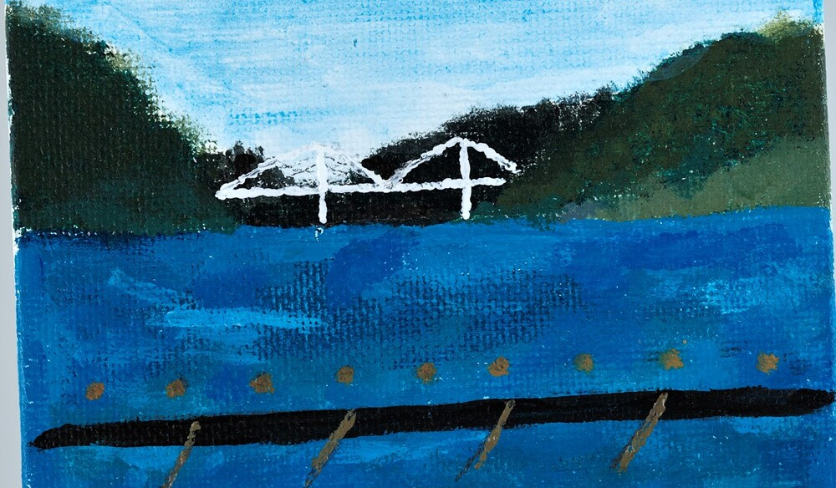
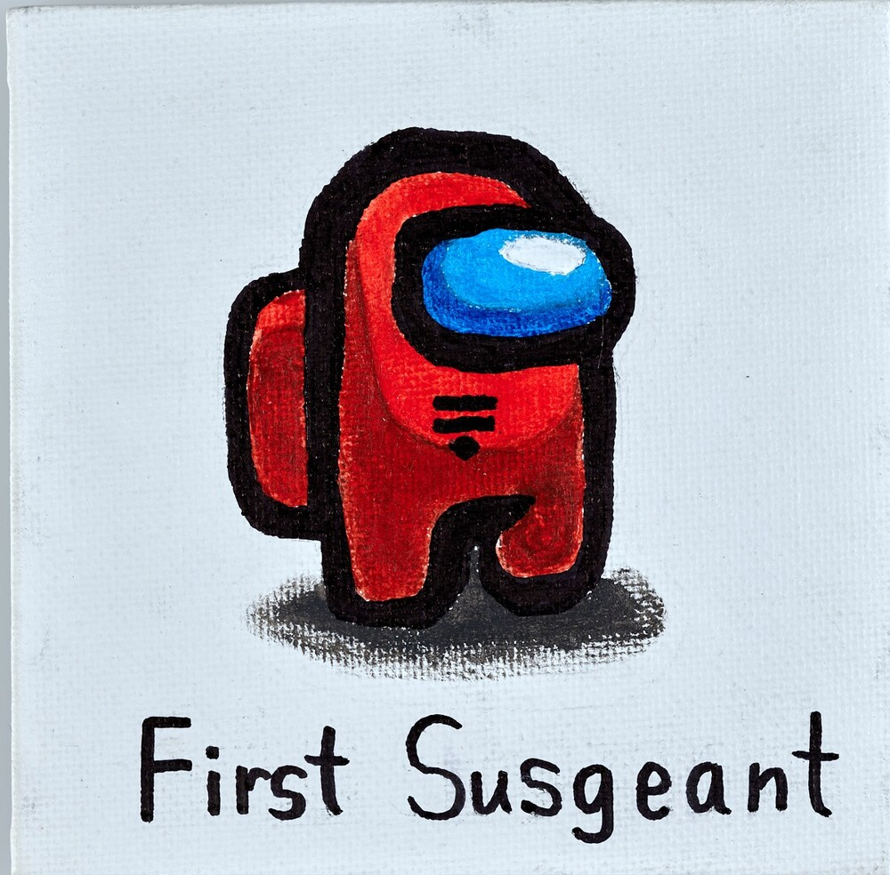

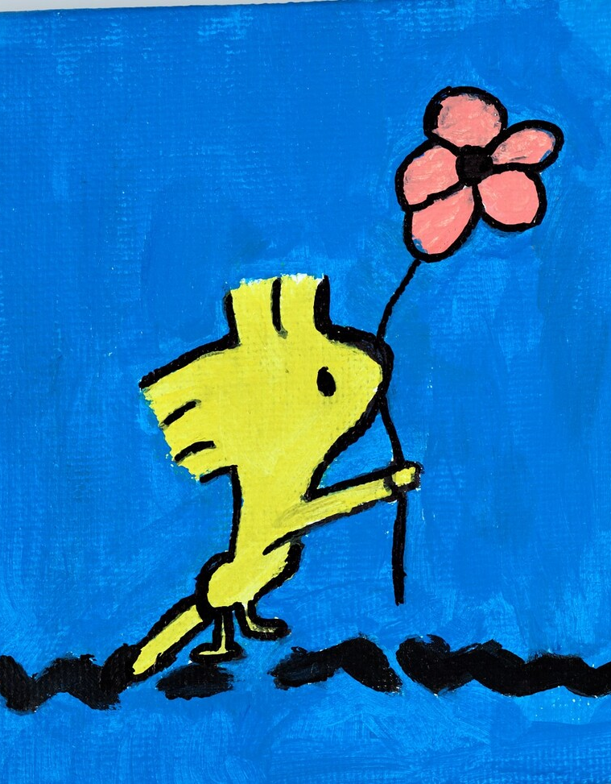
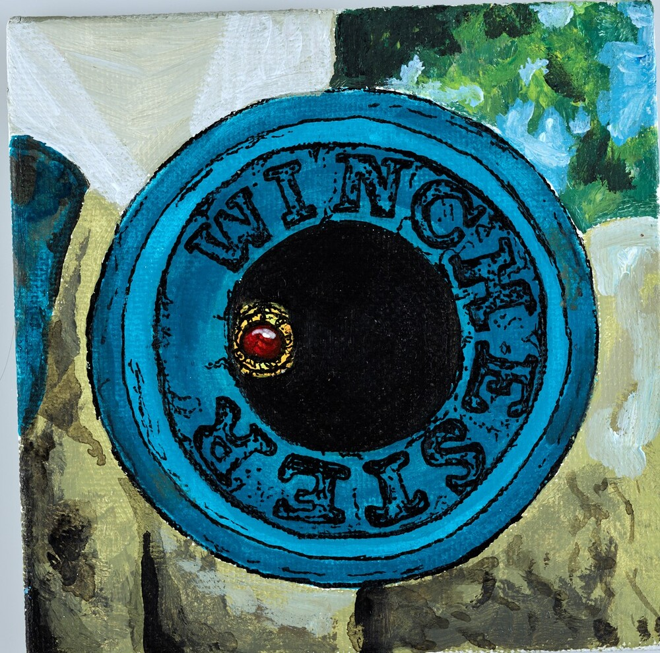
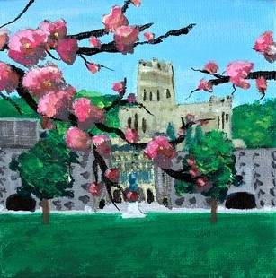
References
Eshbach, Barbara E. “Supporting and Engaging Students through Academic Library Programming.” The Journal of Academic Librarianship 46, no. 3 (May 1, 2020): 102129. https://doi.org/10.1016/j.acalib.2020.102129.
Kasten-Mutkus, Kathleen. "Programming as pedagogy in the academic library." portal: Libraries and the Academy 20, no. 3 (2020): 425-434.
Kohn, Rita. Experiencing Displays. Metuchen, NJ: Scarecrow Press, 1982.
Lacher-Feldman, Jessica.Exhibits in Archives and Special Collections Libraries. Chicago: Society of American Archivists, 2013.
Research, Center for Drug Evaluation and. “Institutional Review Boards (IRBs) and Protection of Human Subjects in Clinical Trials.” FDA, February 22, 2023. https://www.fda.gov/about-fda/center-drug-evaluation-and-research-cder/institutional-review-boards-irbs-and-protection-human-subjects-clinical-trials.
Skolnick, Lee. What is Exhibition Design? Switzerland and UK: RotoVision, 2007.
Willey, Paula, and Andria L. Amaral. The Passive Programming Playbook: 101 Ways to Get Library Customers off the Sidelines. Santa Barbara, California; Denver, Colorado: Libraries Unlimited, an imprint of ABC-CLIO, LLC, 2021.

